Slide 1


© Strupeit, Kushnir, 2022
Intellectual Property Strategy for
Resource-efficient Urban Infrastructures:
Circular Urban Water Treatment and Closure of Material Flows
Lars Strupeit, Ekaterina Kushnir
IIIEE, Lund University, Sweden
Version 1 (01.05.2022)
This is an open access publication distributed under the terms of the Creative Commons Attribution By License, which permits unrestricted use, distribution, and reproduction in any medium, provided the original authors and source are credited.
Citation: Strupeit, L. & Kushnir, E. (2022). Intellectual Property Strategy for Resource-efficient Urban Infrastructures: Circular Urban Water Treatment and Closure of Material Flows. Lund University. Lund, Sweden.

Slide 2

About the case company
The case company has developed and offers integrated engineering solutions to close water, energy, food, and waste loops through a system of decentralized urban water treatment systems. It was founded 2012 as a family business, and has since then expanded into several geographic regions, including Western and Northern Europe, the Persian Gulf region, as well as China and South East Asia.
Main company offerings:
The company has created a modular, expandable and platform-based water treatment system for complex circular urban water treatment and management that can be integrated well into the urban environment. In addition to the clean-up of waste water, the technology enables to derive energy, organic materials, and minerals from organic waste. Nutrients can be recirculated back to enable food production through urban vertical farming. Next levels of circularity for the treatment of organic waste and the provision of value-added products are in a pre-commercial stage.
Sustainability focus:
By shifting resource flows from the predominant linear and flow-through system, towards a more cyclical structure that reduces resource consumption and waste production simultaneously, the company addresses resource and waste challenges in today’s rapidly urbanizing world. Furthermore, the decentralized treatment systems can optionally house space for community functions and serve as a site for urban food production.
Sustainable business model: Maximising water efficiency & closing resource loops
The company operates in the B2B segment with municipalities, real estate developers, and industrial companies as their main customers. The company serves as technology and solutions provider of the know-how-intensive treatment technology, and in addition provides related consulting and engineering services. Projects are implemented in partnership with general contractors. The case company is member of several international research consortia, funded amongst others by the European Commission.

Slide 3
IP asset portfolio of case company
Utility model, trade secrets & know-how
The core IP assets of the case company are safeguarded in the form of utility models, know-how and trade secrets. The utility model is specifically applicable to protect the IP of physical equipment. Compared to patents, the utility model is more cost-effective, which makes it an attractive option for start-ups, such as the case company.
Copyrights and design rights
The case company has copyrighted software and algorithms that serve for the modelling of complex biological processes. Design rights apply to the physical appearance of the company´s technology and products.
Patents and trademarks
A part of the case company’s IP is in the form of patents, as well as registered and unregistered trademarks. At the present development stage of the company, patents are of secondary importance though, in particularly in comparison to utility models.
Spot licenses
The case company has issued spot licenses to partners and clients that provides them with the right to use the IP for a specific water treatment plant.

Slide 4
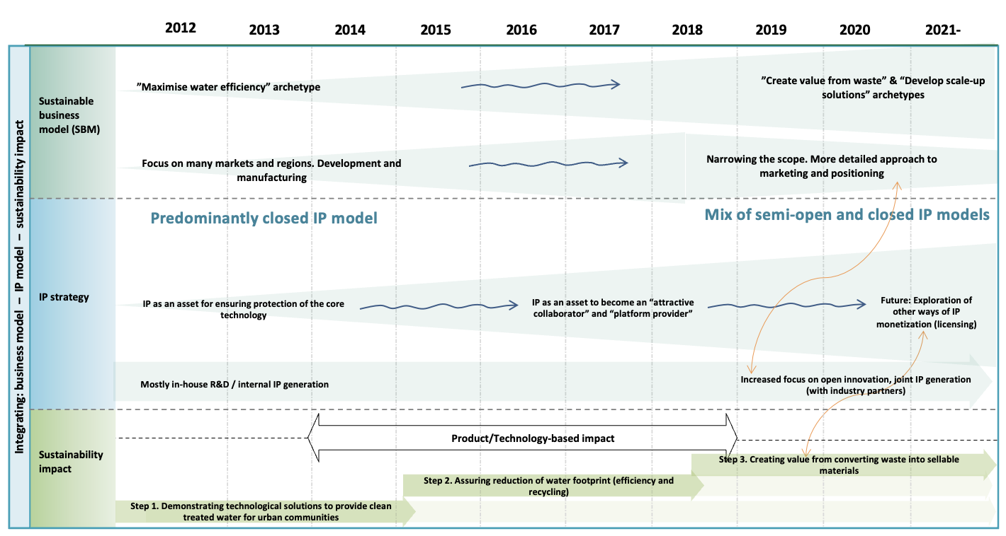
IP strategy of case company

Slide 5



Products sustainability impact of case company
Environmental Impact
Overall reduction in water footprint through increased efficiency, recycling and reuse, and reduction of overall consumption levels.
Closure of resource and nutrient cycles.
Environmental improvement above compliance levels.
Economic
Impact
Monetary value generated from converting waste into sellable materials.
All profits are re-invested into sustainable technologies.
Real estate projects equipped with the circular water treatment system gain added economic value through green branding.
Community development through improved health and sanitation; to date installed plants serve one million people with clean treated waste water.
The highly visible and aesthetically appealing plants can be integrated well into an urban context, thereby raising social acceptance to waste water treatment and triggering behavioural change in respect to sustainability matters in general.
The decentralized treatment systems can optionally house space for community functions as well as urban food production.
Social
Impact

Slide 6
Key learnings: IP strategies for sustainability
Initially, the case company maintained a predominantly closed IP model, with all the key IP assets being generated in-house. The objective was to gain technical proof-of-concept and external acknowledgement for their radical innovation of a complex water treatment technology, while keeping its IP protected.
The value proposition gradually shifted from the initial ”Maximise water efficiency” archetype towards ”Create value from waste” & “Develop scale-up solutions” archetypes. This required new strategic partnerships to access complementary competences, resulting in a shift towards more open forms of joint IP generation with the new industry partners.
In terms of geography, the company partially focused on mature markets with high competence in water management solutions. Successful proof-of-concept in these markets has been critical to add credibility to their product and is expected to facilitate expansion to other regions. Exploration of other ways of IP monetization, e.g. through licensing, is presently considered, especially in order to disseminate and scale-up the technology in markets that the case company cannot easily access on its own.
Furthermore, participation in ongoing EU-funded research projects is expected to result in the generation of shared IP assets.
Finally, the case company operates a separate non-profit research and development branch that focuses on process and product development. Interested stakeholders, including universities, research institutions, and individuals are invited to cooperate in joint R&D or in a cross-licensing setup to adapt and integrate their technologies into the case company’s core platform.

Slide 7
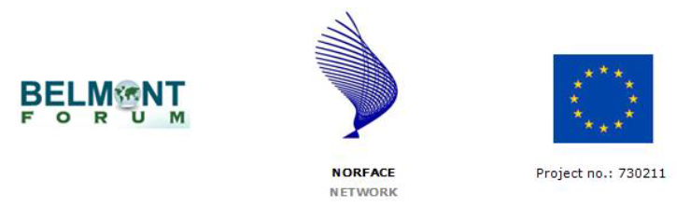
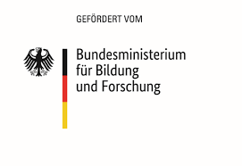

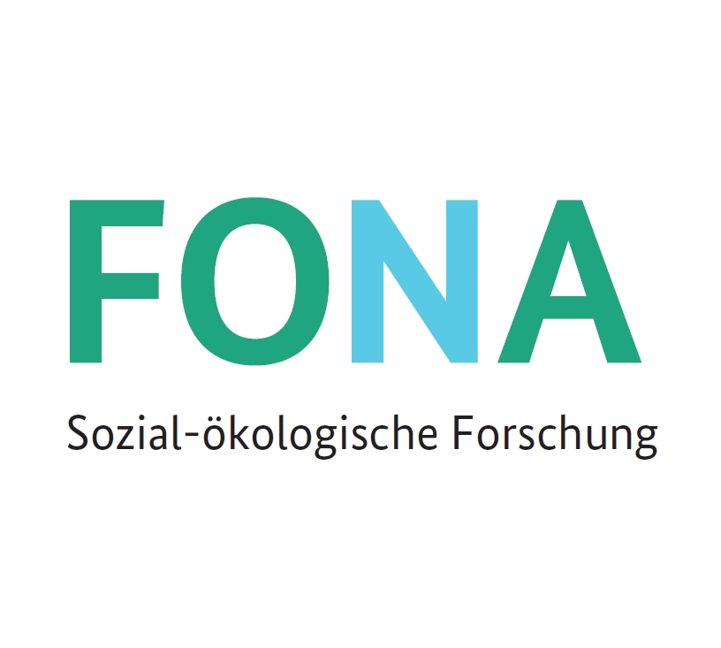



Website: www.ip4sustainability.org
Twitter: @ip4sust
Contact: lars.strupeit@iiiee.lu.se
Funding support: The project IPACST is financially supported by the Belmont Forum and NORFACE Joint Research Programme on Transformations to Sustainability, which is co-funded by DLR/BMBF FONA-SÖF 01UV1812A and 01UV1812B, GCRF, ESRC (ES/S008322/1), VR 2017-06439, and the European Commission through Horizon 2020.

