Slide 1


© Vimalnath, Tietze, Elsen, 2022
Intellectual Property Strategy for Humanitarian Aid:
A Social Impact Case Study of Nutriset®
Pratheeba Vimalnath, Frank Tietze, Maximillian Elsen
Innovation and Intellectual Property Management (IIPM) Laboratory
Institute for Manufacturing, Department of Engineering, University of Cambridge, UK
Version 3 (08.12.2021)
This is an open access publication distributed under the terms of the Creative Commons Attribution By License, which permits unrestricted use, distribution, and reproduction in any medium, provided the original authors and source are credited.
Citation: Vimalnath, P., F. Tietze and M. Elsen (2022). Intellectual Property Strategy for Humanitarian Aid: A Social Impact Case Study of Nutriset®. University of Cambridge. Cambridge, UK.

Slide 2

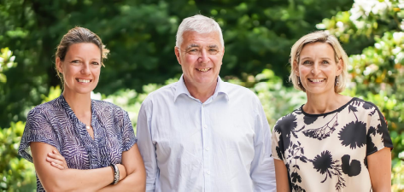
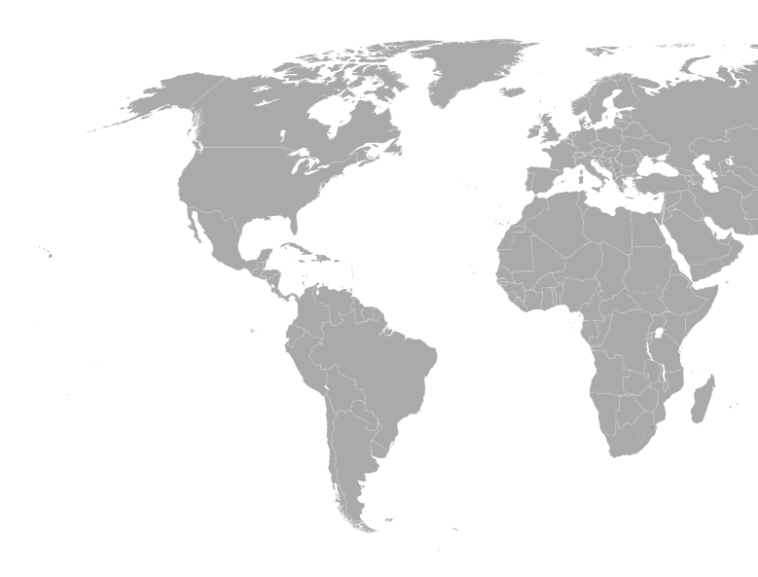

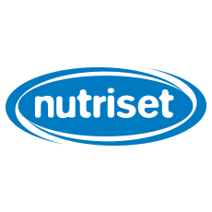


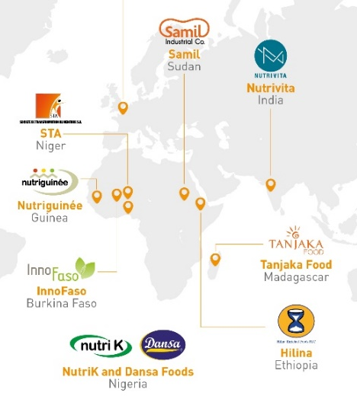

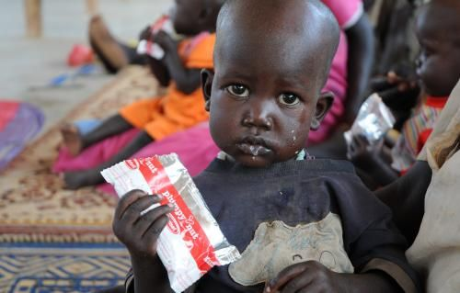
About Nutriset®
Nutriset® is a mission driven, innovative nutritional product manufacturer striving to provide “nutritional autonomy for all”.
Founded in 1986 by Michel Lescanne as a family business in France, Nutriset® is a private sector pioneer in bringing together scientific innovations and industrial excellence with social and environmental responsibility for treatment and prevention of malnutrition among vulnerable populations. The company has 60 research partnerships globally. In 2019, the company had a turnover of €114 million. As of 2021, Nutriset®’s range of products have over 10 million beneficiaries worldwide.
1) Patents for blocking
developed country manufacturers
Source: https://www.nutriset.fr/articles/en/why-nutriset-became-the-first-company-to-adopt-an-expanded-corporate-purpose
Sustainable business model (SBM): Nutriset®’s key value propositions is its peanut-based ready-to-use therapeutic food (RUTF) as treatment for malnutrition known as Plumpy’Nut®. The company adopts a combination of a stewardship (SBM–1) and an inclusive value creation (SBM-2) business models. At the heart of the stewardship business model sits a franchise model, the PlumpyField® Network. The company has signed franchise agreements with 12 PlumpyField® Network partners operating local production sites, predominantly in least developed countries (LDCs) and low- and middle-income countries (LMICs). This combination allows Nutriset® to create, deliver and capture value through its clients (e.g. NGOs, health organizations) and beneficiaries (e.g. malnourished children, pregnant women and mother of newborn).
2) IP licensing to
LDC/LMIC franchisees
Responsible IP strategy: In developed countries, Nutriset® uses patents to block companies from cheaper mass production. The company licenses their IP (incl. patents, trade marks, manufacturing know-how) to franchisees in LDCs/LMICs, such as such as Burkina Faso, Nigeria, Madagascar and Ethiopia, which have a high need for Nutriset® products.
Impact on treating malnutrition: In 2007, World Health Organization (EHO), the World Food Programme (WFP), the United Nations System Standing Committee on Nutrition (UNS SCN) and the United Nations Children’s Fund (UNICEF), in a joint statement recognized RUTF as the ideal treatment for severe acute malnutrition.
Nutriset® has been recognized for its strategic use of IP for creating positive socio-economic development. The company is one of the very few that has been awarded both the European Inventor Award by the European Patent Office (EPO) and Patents for Humanity Award by the US Patent and Trademark Office (USPTO) in 2015.
Source: https://www.pinterest.co.uk/pin/206250857907956833/

Slide 3
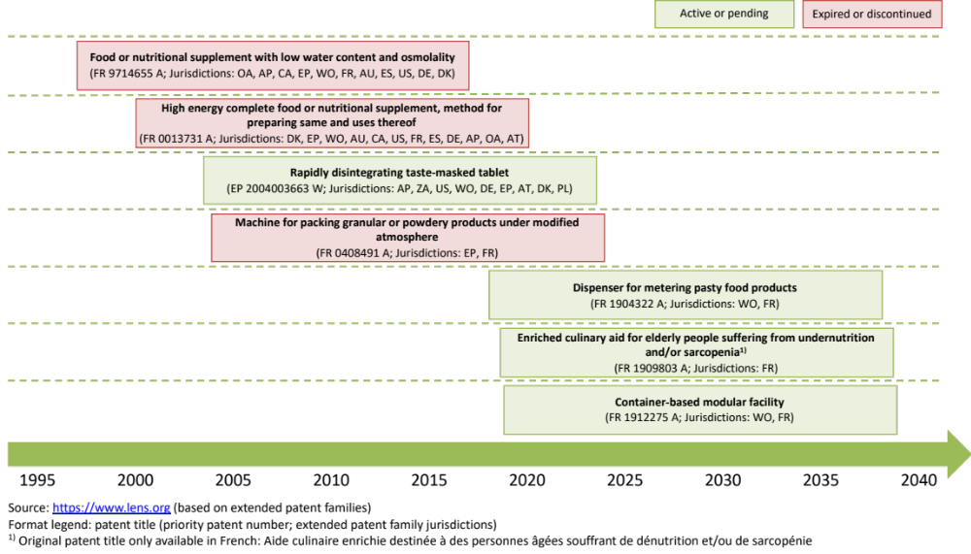

















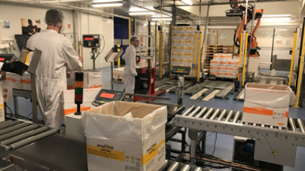

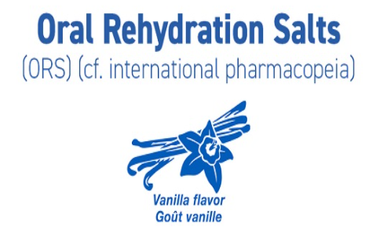




Nutriset®’s IP asset portfolio
Patent portfolio
Trademark portfolio
Company name
Business/ franchise model
Product ranges/ product names
Know-how
Technical know-how, such as about production processes of therapeutic products and scale-up; Industrial know-how, e.g. for setting up industrial units
Source: https://www.nutriset.fr/en/history

Slide 4
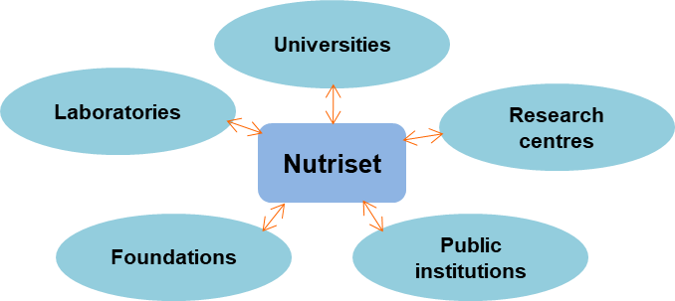
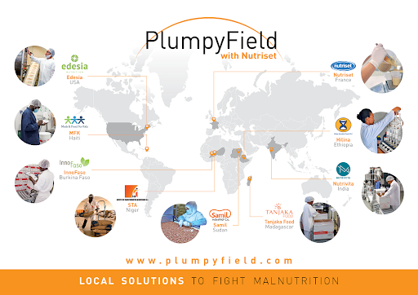
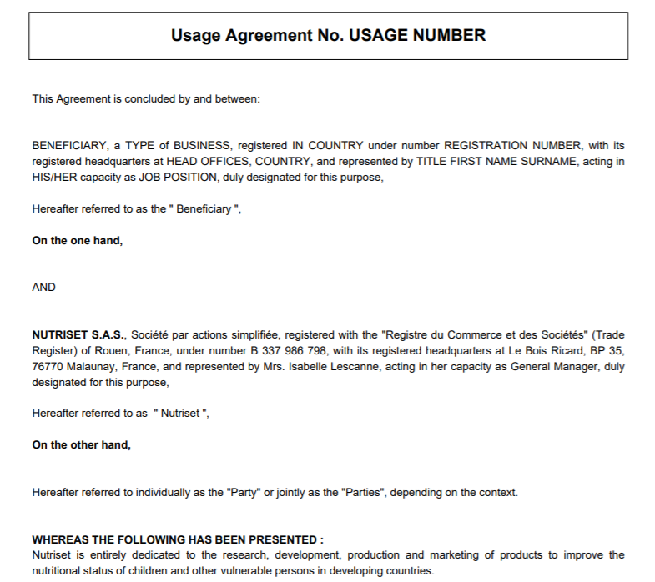
Nutriset®’s IP strategy
“Clearly if we had not had an IP strategy at the beginning of 2000, we were not being able to set up local companies in many countries... We cannot talk about development in this context without IP. It is closely linked. The sustainable devoted business model we have right now is clearly linked to the IP strategy we took.”
- Thomas Couaillet, Managing Director
1986
1993
1997
2005
2010
2021
Nutriset® founded
First product launch
First patent filed
Patent usage agreement
Recent developments
Value creation & capture: Collaborative R&D, manufacturing, production and sale of therapeutic products
Private IP model (Closed type)
Independent/joint IP ownership - exclusivity through IP protection to control IP usage and freedom to operate
Recently moving into secrecy
Actor specific - denial of IP commercialization rights to developed country manufacturers
Source: Own creation
SBM-1: Adopt a stewardship role, Franchise model -
PlumpyFiled® Network
Club IP model (Semi-open type 1)
Transfer of technical and industrial know-how, commercial usage rights to patents and trademarks
Actor & market specific - Local manufacturers in LMICs
Source: https://nutrivita.in/about-us/
SBM-2: Inclusive value creation, Patent licensing as business model
Common IP model (Semi-open type 2)
Patent usage agreement without know-how transfer
Actor & market specific - Local entrepreneurs in LMICs where Nutriset do not have its presence
Little attention by the private sector to the issue of malnutrition and no dedicated nutritional solution available for effectively treating malnutrition
Controversies over likely patent monopoly - criticisms from humanitarian actors and other private players in the nutritional industry^{1,2,3}
Emerging competition in LMICs – cheaper products from LMIC manufacturers
Sources: ¹http://news.bbc.co.uk/2/hi/europe/8610427.stm; ²https://www.thenewhumanitarian.org/news/2010/01/12/plumpynut-patent-under-pressure; ³https://msfaccess.org/msf-nutriset-patent-impeding-access-treatment-severe-acute-malnutrition

Slide 5
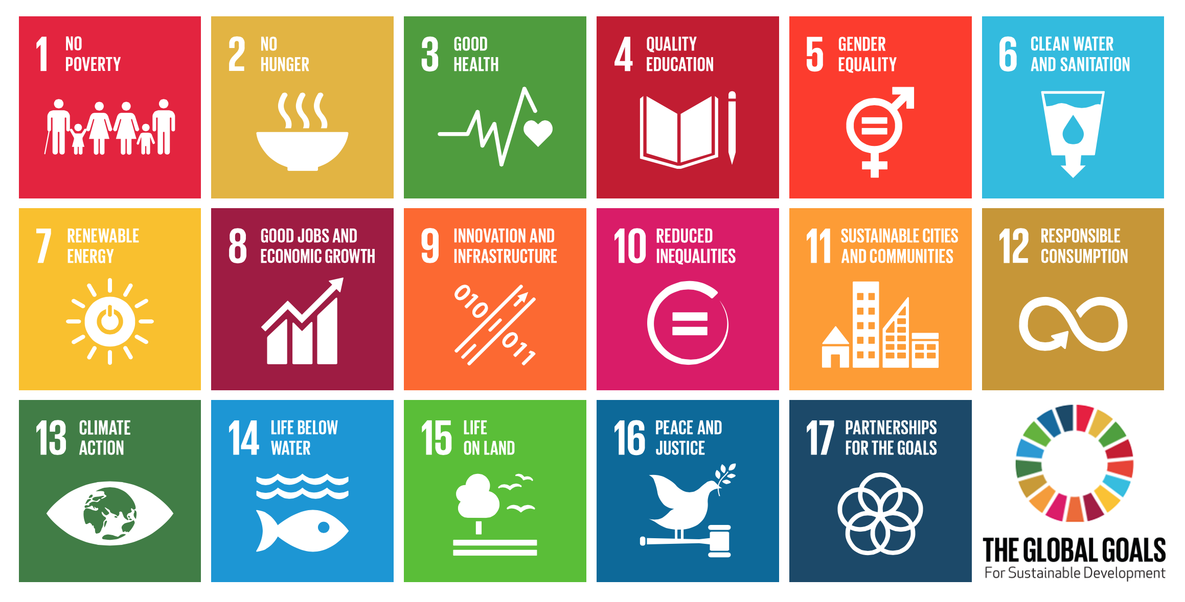



Nutriset®’s sustainability impact
Nutriset® group contributes to ten of the 17 SDGs. The company’s malnutrition business
contributes particularly to the no poverty (SDG#1) and zero hunger (SGD#2) goals
Nutrition & health improvements among 10 million beneficiaries in the vulnerable
population worldwide as of 2021
Partnerships for sustainable practices for empowerment, improved livelihood, local community development around 12 franchise sites in LMICs with vulnerable population, e.g in Hilina, PlumpyField® improved the standard of living of the franchisees’ employees who earn 23% more than in previous jobs
Social
Impact
Environmental Impact
Reduced environmental footprint through procurement of local produce, e.g. locally grown peanuts
Reduced carbon footprint due to shorter distances Nutriset®’s products travel from production sites to beneficiaries
Reduced consumption in local production sites through energy saving programs and program to monitor and control water effluents from laboratory activities
Economic
Impact
Contribution of socially sustainable technologies in profit and sales: Nutriset® generated turnover of €114 million in 2019
Re-investment of profits into sustainable technologies and practices, e.g. continuous R&D of socially valuable innovation. More than €10 million for financing the agroindustry in LDCs /LMICs since 2007
Expenditure on community programs – e.g. WASH’Nutrition program

Slide 6
Key learnings: IP strategies for sustainability
Similar to solely economic-driven businesses, formal and informal IP assets can constitute important business assets for mission-driven firms when aiming to achieve SDGs, such as in the humanitarian sector.
A strategic understanding of which IP models to choose and how to combine them can help private sector actors contribute to achieving SDGs, without compromising economic gains.
Even Private IP models can play a role for achieving SDGs, e.g. preventing markets from being flooded with cheap copycats. Private IP models can be used to establish a lead time to then roll out Club-IP models (semi-open 1).
Outbound facing Club IP models (semi-open type 1) can be used to transfer formal and informal IP under fair licensing terms and affordable royalty rates to promote sustainable development in LDCs/LMICs. Common IP model (semi-open 2) can complement the Club IP model to increase value capture and sustainability impact through inclusive value creation.
If used in a suitable context, an outbound Club IP model (semi-open 1) can:
  create social impact through job creation and livelihood generation for local community and vulnerable populations in LDCs/LMICs,
  facilitate company to sector sustainability transitions at early stages through nurturing an environment conducive for start-up/niche creation.
If key ecosystem stakeholders (e.g., in the humanitarian aid community) possess an overly critic view of IP, paired with a lack of IP understanding this can pressure mission-driven, innovative private sector actors to pivot/fall back towards even closer, trade secrecy-based IP models.

Slide 7
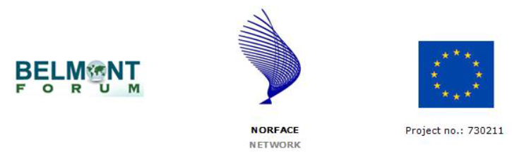
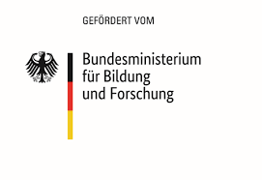
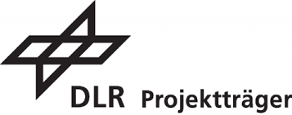



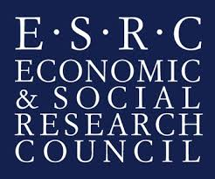
Website: www.ip4sustainability.org
Twitter: @ip4sust
Contact: pv302@cam.ac.uk | ft263@cam.ac.uk | mhce2@cam.ac.uk
Funding support: The project IPACST is financially supported by the Belmont Forum and NORFACE Joint Research Programme on Transformations to Sustainability, which is co-funded by DLR/BMBF FONA-SÖF 01UV1812A and 01UV1812B, GCRF, ESRC (ES/S008322/1), VR 2017-06439, and the European Commission through Horizon 2020.

