Slide 1


© Vimalnath, Tietze, Elsen, 2022
Intellectual Property (IP) and IP Sharing Models:
An Introduction
Pratheeba Vimalnath, Frank Tietze, Maximillian Elsen
Innovation and Intellectual Property Management (IIPM) Laboratory
Institute for Manufacturing, Department of Engineering, University of Cambridge, UK
Version 3 (05.04.2022)
This is an open access publication distributed under the terms of the Creative Commons Attribution By License, which permits unrestricted use, distribution, and reproduction in any medium, provided the original authors and source are credited.
Citation: Vimalnath, P., F. Tietze and M. Elsen (2022). Introduction to Intellectual Property. University of Cambridge. Cambridge, UK.

Slide 2

Learning Objectives
Know what is an intellectual property (IP), an IP right (IPR) and an IP system
Learn about different types of IP assets and their relevance for businesses
Learn to do prior-art searches and gain insights about different IP databases and search techniques
Understand different types of IP sharing models and its relevance to formulating an organisation’s IP strategy
Notes:
After this presentation, you will,
know what is an intellectual property (IP), an IP right (IPR) and an IP system
learn about different types of IP assets and their relevance for businesses
learn to do prior-art search and gain insights about different IP databases and search techniques
understand different types of IP sharing models and its relevance to formulating an organisation’s IP strategy

Slide 3
What is Intellectual Property?
“Intellectual property (IP) refers to creations of the mind, such as inventions, literary and artistic works, designs, and symbols, names and images used in commerce”
World Intellectual Property Organization (WIPO)¹
Intellectual property rights (IPRs) are the “rights given to creators over the creations of their minds [by a governmental authority]. They usually give the creator an exclusive right over the use of his/her creation for a certain period of time”
- World Trade Organization (WTO)²
¹ www.wipo.int/about-ip/en/#:~:text=Intellectual%20property%20(IP)%20refers%20to,and%20images%20used%20in%20commerce.
² www.wto.org/english/tratop_e/trips_e/intel1_e.htm

Slide 4
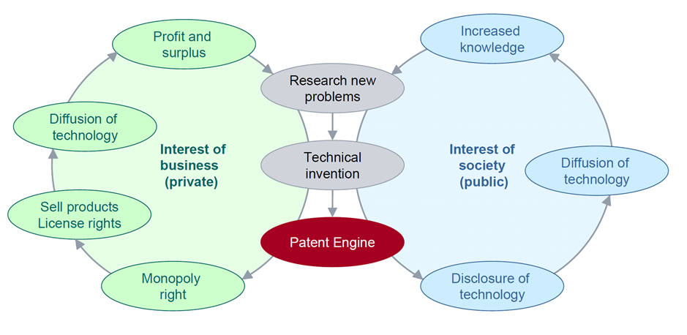
IPR systems
Economic reasoning/justification for IPR systems:
Balancing societal and private interests for investments in IP creation

Slide 5
IP governing bodies and treaties
WIPO – World Intellectual Property Organization (https://www.wipo.int/portal/en/)
WTO – World Trade Organization (https://www.wto.org/)
EPO – European Patent Office (https://www.epo.org/)
National patent offices: Each country has its own patent office governed by its own patent laws falling within the TRIPS guidelines
Details about national patent laws can be accessed free of charge at WIPO Lex https://www.wipo.int/wipolex/en/index.html
TRIPs agreement (1 January 1995), multilateral agreement on IP (https://www.wto.org/english/tratop_e/trips_e/intel2_e.htm#:~:text=The%20TRIPS%20Agreement%20requires%20Member,novelty%2C%20inventiveness%20and%20industrial%20applicability)
Notes:
IP and associated rights are typically governed by national legal systems that are not always harmonized internationally.

Slide 6
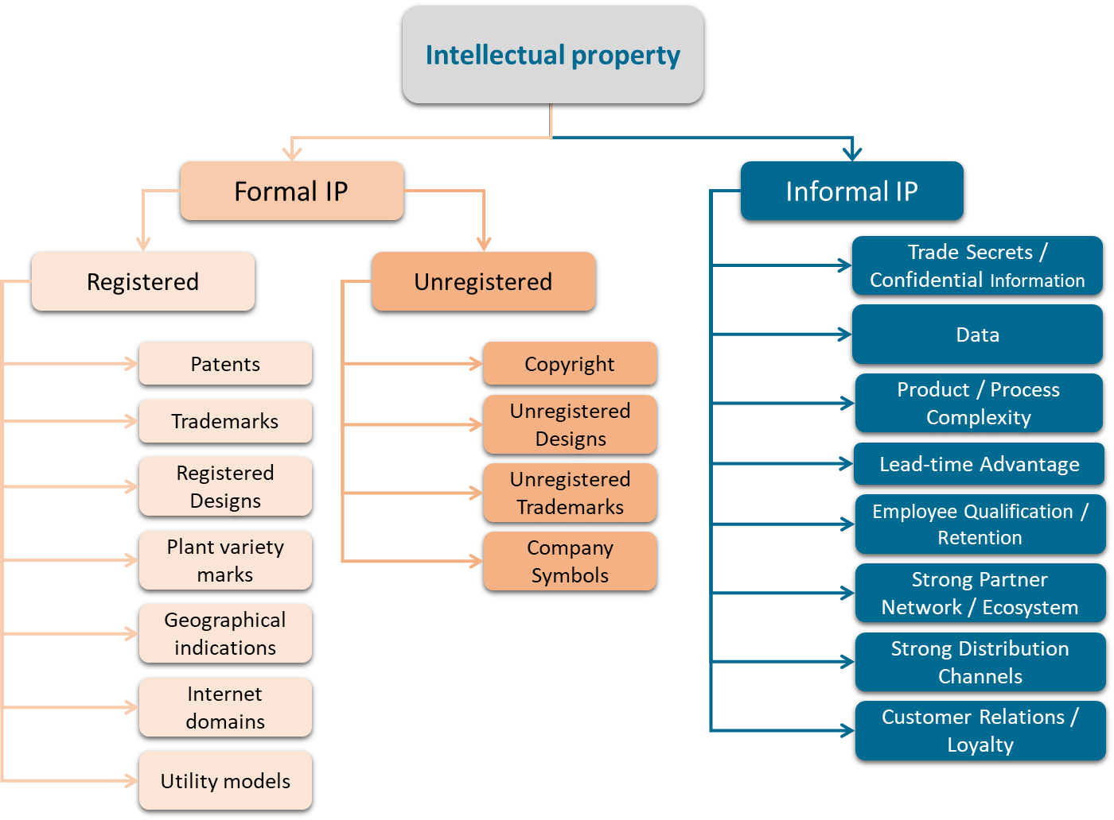
Types of IP assets
Source: University of Cambridge (2021)
Notes:
There is a wide range of IP types, broadly classified as formal and informal IP asset. Formal IP assets include registered IP rights such as patents, registered trademarks, registered design rights and utility models, and unregistered IP rights such as copyright, unregistered marks and designs and trade secrets. Informal IP assets include those IP assets that are not formally registered or protected via a governing IP system such as know-how, algorithms and data.
Patent protect process, machine, manufacture, or composition of matter, computer implemented inventions or any improvement thereof (Duration of protection: 20 years for utility patent, 14 years for design patent (in US)) Copyright – Software code, literary, dramatic, musical, artistic (Duration if protection: authors’ life + 70 years)
Trademark protect word, name, symbol, or any combination, used, or intended to be used, in commerce to identify and distinguish the goods or services, like logo, banner, sound, smell (Duration of protection: infinite, but typically with 10 year renewals)
Trade secret protect information and know-how of economic value that is kept secret, like formulas, patterns, compilations, programs, AI algorithms, customer data, devices, methods, production/ assembly techniques or processes (Duration of protection: As long as the secrecy is maintained) Geographical indication is ‘a sign used on goods that have a specific geographical origin and possess qualities or a reputation due to that place of origin’.
Sources: WIPO, EPO, USPTO
Please note that IP and associated rights are typically governed by national legal systems that are not always harmonized internationally. Details provided can vary for certain countries.

Slide 7
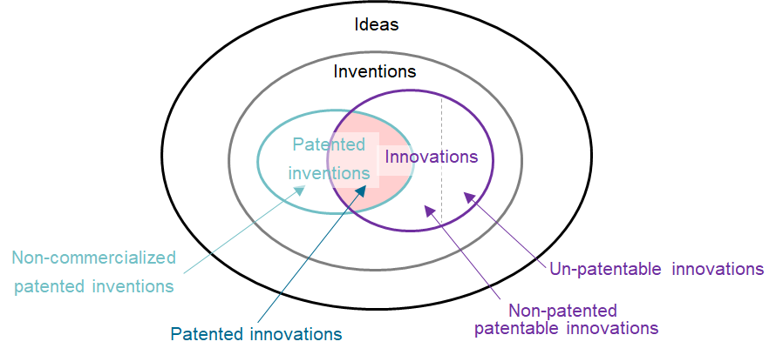
Innovation and intellectual property
Source: University of Cambridge (2021)
Notes:
Not all innovations are patentable

Slide 8

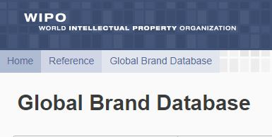




IP databases and prior-art search
Official and free IP databases
Free third-party search engines
https://patentscope.wipo.int/search/en/search.jsf
https://branddb.wipo.int/branddb/en/
https://www.lens.org/
https://patents.google.com/
https://worldwide.espacenet.com/
https://www.uspto.gov/patents/search
Prior art search
Key word search
Patent classification search (e.g., YO2 for climate change mitigation technologies)
Prior art analysis
Analysis of patent variables
Citation analysis
Text mining
Machine learning and AI algorithms

Slide 9
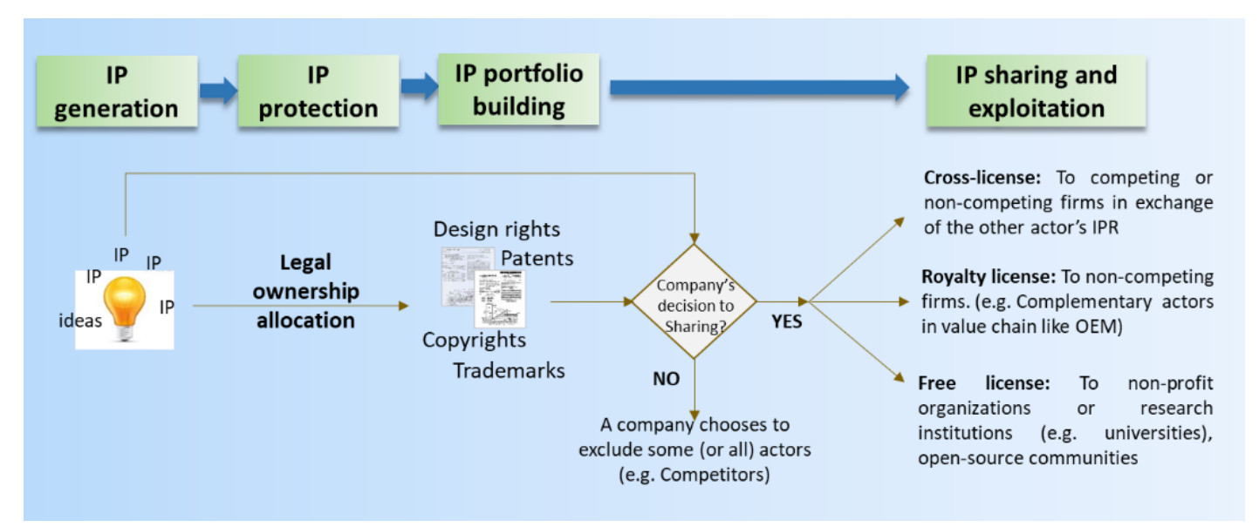
IP generation and sharing/exploitation
Source: IPACST - IP knowledge brief, https://ip4sustainability.files.wordpress.com/2021/10/intellectual-property-knowledge-brief-1.pdf

Slide 10
IP sharing models and IP strategy
IP model refers to the way owners of intellectual property (e.g. firms, not-for profit organizations, social ventures, universities, public bodies, individuals, academics) control the ownership, access and usage rights of the IP by the owner itself and others (Vimalnath et al., 2020).
IP strategy is a set of activities and guidance process for decision-making regarding the selection and combination of different IP models to maximize the value creation from an organization’s inventions like technologies, products, services, literary and artistic works, design, symbols, names and images in support of, and alignment with, its organizational objectives (Vimalnath et al., 2020).
Source: IPACST glossary - https://ip4sustainability.files.wordpress.com/2021/09/glossary-knowledge-brief-1.pdf
Vimalnath, P., F. Tietze, E. Eppinger and J. Sternkopf. Closed, semi-open or fully-open? Towards an intellectual property strategy typology. 80th Annual Meeting of the Academy of Management, Vancouver, Canada, August 7-11, 2020

Slide 11
IP sharing model typology
Degree of openness
Type of IP model
Private IP model
Club IP model
Common IP model
Public IP model
IP ownership right concentration
Ownership is highly concentrated to one or very few actors
Ownership is relatively highly concentrated on few actors
Ownership is concentrated or distributed to several / many owners
No one owns the IP (anymore). IP is in the public domain
Access to IP¹
Owners strictly prevent others from accessing ‘their’ IP
Owners allow only members of the club to access ‘their’ IP. Entry barriers are high for outsider actors.
Owners allow almost anyone to access ‘their’ IP with or without contributing IP. Entry barriers are relatively low for outsider actors.
Owners allow anyone to access ‘their’ IP
Owners entirely restrict others from commercial usage of ‘their’ IP
Owners entitle only members of the club for commercial usage of ‘their’ IP. Owners prohibit non-members from commercial usage of ‘their’ IP.
Owners allow almost anyone to use ‘their’ IP but with some commercial restrictions
Owners cannot/do not restrict anyone from commercial usage of ‘their’ IP
Commercial usage of IP²
Closed
IP model
Semi-open type 1
IP model
Semi-open type 2 IP model
Fully open
IP model
¹Across all models, owners cannot restrict access to their publicly disclosed IP (e.g., in patent documents).
²Across all models, owners may not be able to restrict non-commercial under certain exemptions (e.g., for research, academic use)
Source: Vimalnath, P., F. Tietze, E. Eppinger and J. Sternkopf. Closed, semi-open or fully-open? Towards an intellectual property strategy typology. 80th Annual Meeting of the Academy of Management, Vancouver, Canada, August 7-11, 2020

Slide 12
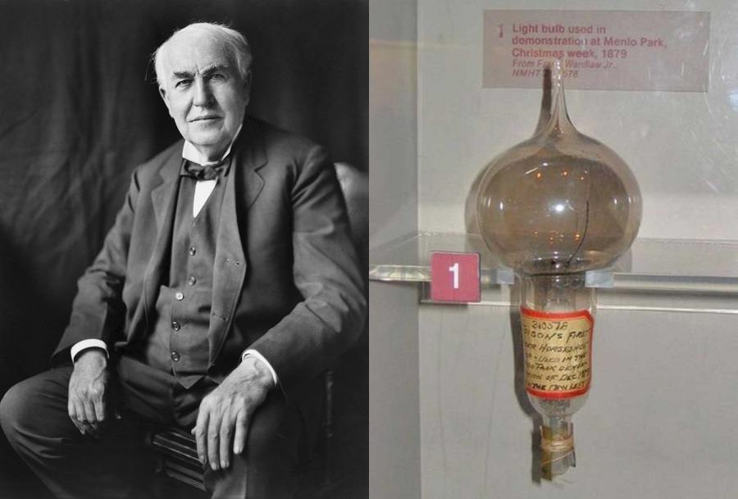



Private (closed) IP model
Type of IP model
Private IP model
Trade secrets
Single owner IPR
3
IP ownership right allocation
Ownership is highly concentrated to one or very few actors
Edison’s light bulb patent
Herbs mix
Access to IP¹
Owners strictly prevent others from accessing ‘their’ IP
DSM Dyneema ® patent
Secret recipe of the cola
Commercial usage of IP²
Owners entirely restrict others from commercial usage of ‘their’ IP
Firms employing private IP models rigorously protect their IP, disclose as little IP as possible, vigilantly monitor, oppose and litigate others’ patent applications to prevent patents by third parties to potentially restrict them in using their IP (Chen et al., 2016).
Closed IP model
Variance within the category is due to secrecy
³https://allthatsinteresting.com/wordpress/wp-content/uploads/2016/03/edison-first-bulb.jpg

Slide 13






Club (semi-open type 1) IP model
Type of IP model
Club IP model
Decentralized IP sharing – Patent Pool model
Bilateral IP sharing – unidirectional
IP ownership right allocation
Ownership is relatively highly concentrated on few actors
Exclusive licensing of cellophane
Access to IP¹
Owners allow only members of the club to access ‘their’ IP. Entry barriers are high for outsider actors.
Pool of IP
Commercial usage of IP²
Owners entitle only members of the club for commercial usage of ‘their’ IP. Owners prohibit non-members from commercial usage of ‘their’ IP.
Patent pool to share IP for their rewriteable audio compact disc patents in the 1990s
Semi-open type 1 IP model

Slide 14
Club (semi-open type 1) IP model
Bilateral IP sharing – unidirectional
e.g. exclusive license
Bilateral IP sharing – bidirectional
e.g. single cross-license
Centralized IP sharing – integrator model
e.g. multiple non-exclusive licensing
Centralized IP sharing – integrator model
e.g. multiple non-exclusive licensing
Decentralized IP sharing – patent pool model
e.g. multiple cross-licensing
Decentralized IP sharing – patent Pool model
e.g. IP pool access
. . .
Pool of IP
Solid circle represents participating actors
Solid line represents IP sharing
Arrow head represents directionality of IP sharing
Grey area represents the exchange of undisclosed IP/tacit knowledge
Variance within the category is due to directionality (unidirectional/bidirectional), control system (centralized/ decentralized)

Slide 15



Common (semi-open type 2) IP model
Type of IP model
Common IP model
Commercial restriction
No commercial restriction
IP ownership right allocation
Ownership is concentrated or distributed to several / many owners
Patent pledges by
Owners allow almost anyone to access ‘their’ IP with or without contributing IP. Entry barriers are relatively low for outsider actors.
Non-assertion clause
Access to IP¹
‘Fair’ usage
Open source free license
Commercial usage of IP²
Owners allow almost anyone to use ‘their’ IP but with some commercial restrictions
Variance within the category is due to usage obligations and commercial restrictions
Semi-open type 2 IP model

Slide 16



Public (fully open) IP model
Type of IP model
Public IP model
Expired/ abandoned patents
Open access/ Free access
IP ownership right allocation
No one owns the IP (anymore). IP is in the public domain
3
Access to IP¹
Owners allow anyone to access ‘their’ IP
Open access publications
Commercial usage of IP²
Owners cannot/do not restrict anyone from commercial usage of ‘their’ IP
Variance within the category is due to ease of use of publicly available free IP
Fully open IP model
³http://www.ayvapharma.com/wp-content/uploads/2016/06/generic_drugs-1540x1023_c.jpg

Slide 17







Website: www.ip4sustainability.org
Twitter: @ip4sust
Contact: pv302@cam.ac.uk | ft263@cam.ac.uk | mhce2@cam.ac.uk
Funding support: The project IPACST is financially supported by the Belmont Forum and NORFACE Joint Research Programme on Transformations to Sustainability, which is co-funded by DLR/BMBF FONA-SÖF 01UV1812A and 01UV1812B, GCRF, ESRC (ES/S008322/1), VR 2017-06439, and the European Commission through Horizon 2020.

