Slide 1


© Eppinger, 2022
Sustainability Impact and Sustainability Transition
Akriti Jain, Anjula Gurtoo
Centre for Society and Policy (CSP)
Indian Institute of Science - Bangalore, India
Version 2 (31.03.2022)
This is an open access publication distributed under the terms of the Creative Commons Attribution By License, which permits unrestricted use, distribution, and reproduction in any medium, provided the original authors and source are credited.
Citation: E. Eppinger (2022). Sustainability Impact and Sustainability Transition. HT Berlin. Berlin, Germany.

Slide 2

SI - Key definitions
Sustainable Development refers to the development which, “meets the needs of the present without compromising the ability of future generations to meet their own needs”
The Brundtland Commission, 1987
Firm’s sustainability practices refer to, “activities undertaken by, within or across firms to make the operations of the firm or firms involved more environmentally and/or socially sustainable.”
Jacobsen et al., 2020
Sustainability impact (SI) refers to significant economic, environmental and social effects of an organisation that are: positive, negative, short-term, long-term, actual, potential, direct, indirect.
Sustainability Impact (SI) of organisations are evaluated based on three pillars of sustainable development (also known as Triple Bottom Line (TBL))
1. Environment Impact
2. Social Impact
3. Economic Impact
………………………….
(Sources: OECD ; G4, Sustainability Reporting Guidelines- Global Reporting Initiatives
Notes:
To study the Sustainable Impact of a company, we followed the Sustainability Impact Assessment structure. This meant evaluating the impact of a business’s performance based upon three pillars of sustainable development:
Environment
Social
Economic

Slide 3
SI - Guiding principles & decision criteria
Based on Pinter et al. (2012), and Sala et al (2015)
SI Guiding Principles
SI Framework and indicators
Purpose:
(1) To identify company’s long-term vision and motivation to pursue sustainability practices; (2) To measure company’s actual current and historical sustainability performance based upon Triple Bottom Line (TBL) approach
Stakeholders:
People or organizations who contribute to or benefit from the evaluation of sustainability impact of the company. Stakeholders can be government & rating agencies, customers, investors, researchers & customers who can use impact assessment results
Scope:
Effective identification of SI involves evaluation of both short-term and long-term effects of the unit of analysis. Long-term evaluation helps to capture ecosystem change and anticipate future effects based upon historic and current trends.
Unit of Analysis:
Unit of analysis can be a program, project, product, process, business unit or organization as a whole. In this project unit of analysis is a business unit.
Conceptual framework:
A conceptual framework for to measure sustainability impact of firms involves identification of suitable indicators to measure environment, social and economic effects of firms’ activities and assessing their progress over time.
Criteria of Indicator Selection*:
- Data availability;
- Measurability;
- Select indicators that measure progress (or decline) towards (or away) from sustainability
Sources of data:
Large firms: Company Reports: (1) Annual Performance Reports (2) Environmental Reports (3) Sustainability Reports (4) Business Responsibility Reports (5) Corporate Social Responsibility (CSR) Reports (6) Global Reporting Initiative (GRI) Reports
Small firms: (1) News Reports (2) Media press release (3) interviews (3) Company website etc.
Type of data:
Quantitative (numbers, ratio, range, percentage)
Qualitative (text data through reports and interviews)
*Note: Indicators are selected based on Global Reporting Initiative (GRI) guidelines for indicators’ selection to measure impact over time.
Notes:
To study the Sustainable Impact of a company, we followed the Sustainability Impact Assessment structure. This meant evaluating the impact of a business’s performance based upon three pillars of sustainable development:
Environment
Social
Economic

Slide 4










SI - Environment Impact Indicators
Environment impact is measured in terms of local and global environment impact of company in terms of it’s resource use (water, material, energy), waste generation & management, reduce-reuse-recycle, product and process efficiency, compliance and voluntary actions of organisation to minimize its negative impact on environment.
Based on Azapagic & Perdan (2000), Bae and Smardon (2011)
Local Impact |  | Global Impact |  | Consumption intensity |  | 3R of materials |  |  | Compliance
 | Waste generation & disposal management |  | Reduction in emission of Green House Gas and other ozone depleting substances |  | Increased efficiency (less input per unit of output) |  | Recycling, reuse and recovery |  |  | Suppliers' assessment for sustainable sourcing
 | Overall reduction in consumption (energy, water, etc.) |  |  |  |  |  |  |  |  | Implementing environment management system
 | Use of renewable material |  |  |  |  |  |  |  |  | Environmental improvement above compliance level
 |  |  |  |  |  |  |  |  |  | Reduction in number of environmental violations/allegations
Environmental Impact
Notes:
To study the Sustainable Impact of a company, we followed the Sustainability Impact Assessment structure. This meant evaluating the impact of a business’s performance based upon three pillars of sustainable development:
Environment
Social
Economic

Slide 5









SI - Social Impact Indicators
Social impact is measured in terms of organisations’ internal labour practices to ensure health, safety, equity & growth of employees,; community development and societal practices; and stakeholder engagement programs to address issues like health, safety, education, employment generation etc.
Stakeholders refer to people or organizations who are not formally part of the organization but can contribute to, or benefit from, the value that the organization brings to the table.
Based on Bae and Smardon (2011), and Global Reporting Initiative (2013)
Labour practices |  | Stakeholder engagement |  | Partnerships |  | Community projects |  | Consumers
 | Providing employment opportunity |  | Stakeholders involvement in business decisions |  | Partnerships for sustainable practices |  | Organization of sustainability related campaigns, projects or events in local community |  | Reduction in consumer complaints with respect to base year
 | Ensuring employee health, safety & equity |  |  |  |  |  | Undertaking other community development programs (health, sanitation, education etc.)
 | Internal training and awareness programs on sustainable practices |  |  | `
 | Employee’s representation in trade unions (Human Rights)
Social Impact
Notes:
To study the Sustainable Impact of a company, we followed the Sustainability Impact Assessment structure. This meant evaluating the impact of a business’s performance based upon three pillars of sustainable development:
Environment
Social
Economic

Slide 6









SI - Economic Impact Indicators
Economic impact indicators measure contribution from sustainable technologies in the annual profit, sale and operating cost (with respect to the base year) and percentage of profit re-invested in sustainable technologies. It also measures total annual capital investment in sustainable/renewable technologies and other community programs to ensure sustainable practices
Based on Global Reporting Initiative (2013)
Profit & Performance |  | Cost & Penalties |  | 3R Profit & Expenditure |  | Capital investment |  | T&D Investment |  | Community Investment
 | Contribution of sustainable technologies in profit & sales |  | Change in raw material cost for same output |  | Recycling cost to profit ratio |  | Capital investment in sustainable and renewable technologies |  | Investment in sustainability-based training and development programs |  | Expenditure on community programs (health, education etc.)
 | Re-investment of profit in sustainable technologies |  | Penalty paid for environment violations |  | Expenditure on environment and clean-up initiatives (it may include expenditure on reuse and recycle
Economic Impact
Notes:
To study the Sustainable Impact of a company, we followed the Sustainability Impact Assessment structure. This meant evaluating the impact of a business’s performance based upon three pillars of sustainable development:
Environment
Social
Economic

Slide 7
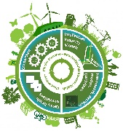
Sustainability Transition

Slide 8
Transition definitions
“shifts in complex technological systems; not only a change in technology, but also quite fundamental changes in production, organization and the way in which people live their lives”
Kemp, 1994
“major changes in technological, organizational and institutional terms for both production and consumption”
Farla et al., 2012
“changes from one sociotechnical regime (STR) to another: STR defined as existing trajectories of cognitive routines, regulations, standards, lifestyle to techical system, investments in machines, infrastructure and competencies
Geels & Schot, 2007
Notes:
To study the Sustainable Impact of a company, we followed the Sustainability Impact Assessment structure. This meant evaluating the impact of a business’s performance based upon three pillars of sustainable development:
Environment
Social
Economic

Slide 9
Sustainability transition (ST)
Definition
“long-term, multi-dimensional, and fundamental transformation processes through which established socio-technical systems shift to more sustainable modes of production and consumption.”
Markard et al., 2012
Socio-technical systems are networks of actors (firms, individuals, other organisations), institutions (norms, regulations, standards, practices), technology, material artefacts and knowledge. Some examples of socio-technical systems are transportation system, energy system, water system, among others
Key features or characteristics of ST
Long-term
Multi-actor
Multi-dimensional
Co-evolutionary
Uncertain and open-ended
Notes:
To study the Sustainable Impact of a company, we followed the Sustainability Impact Assessment structure. This meant evaluating the impact of a business’s performance based upon three pillars of sustainable development:
Environment
Social
Economic

Slide 10
ST – Key frameworks
Strategic Niche Management
Advocates the creation and support of (sustainable) technological niches that get transformed to market niches and trigger policy or regime shift (Kemp et al., 1998)
Technological Innovation System
Focuses on components of a technological system and advocates functions like R&D, market formation, entrepreneurial experimentation and creation of positive externalities as drivers of transition (Markard et al., 2012)
Multi-level Perspective
Visualizes transition as the interplay of dynamics at three levels i.e. micro (niche), meso (regime) and macro (landscape) (Geels, 2002). It emphasizes that internal momentum of niches and external landscape pressure simultaneously put pressure on existing regime leading to regime shift.
Transition Management
Advocates four levels of governance activities to influence long-term sustainability: strategic (goal-setting for long term change), tactical (collaboration and networking), operational (day-to day operations) and reflexive (assessment of current situations) (Loorbach, 2013)
Notes:
To study the Sustainable Impact of a company, we followed the Sustainability Impact Assessment structure. This meant evaluating the impact of a business’s performance based upon three pillars of sustainable development:
Environment
Social
Economic

Slide 11
ST – Multilevel Perspective (MLP) framework
Conceptualizes transition as the interplay of dynamics at the three levels:
Niche,
Regime, and
Landscape level (Geels, 2002)
Niches (micro level) are protected spaces like markets, applications or technologies where radical innovation brings about change by breaking lock-ins, path dependence and stability
Regimes (meso level) represent a set of rules and structures that can be regulatory (standards and laws), cognitive (belief systems, societal goals, innovation agenda, guiding principles) and normative (values and behavioural norms) rules
Landscape (macro level) involves exogenous societal, cultural or environmental changes that take place slowly (over decades)
Notes:
To study the Sustainable Impact of a company, we followed the Sustainability Impact Assessment structure. This meant evaluating the impact of a business’s performance based upon three pillars of sustainable development:
Environment
Social
Economic

Slide 12
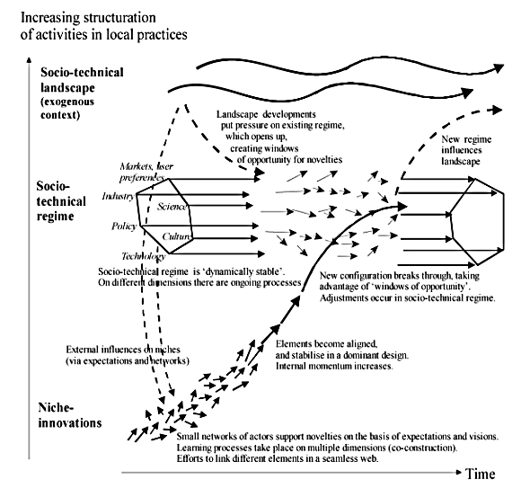
ST – Multilevel Perspective (MLP) framework
Key dynamics:
Niche-innovations gradually build up internal momentum,
Niche-innovations and landscape changes create pressure on the system and regime,
Destabilization of the regime creates windows of opportunity for niche-innovations,
Niche-innovations diffuse and disrupt the existing system
Geels & Schot, 2007
Notes:
To study the Sustainable Impact of a company, we followed the Sustainability Impact Assessment structure. This meant evaluating the impact of a business’s performance based upon three pillars of sustainable development:
Environment
Social
Economic

Slide 13
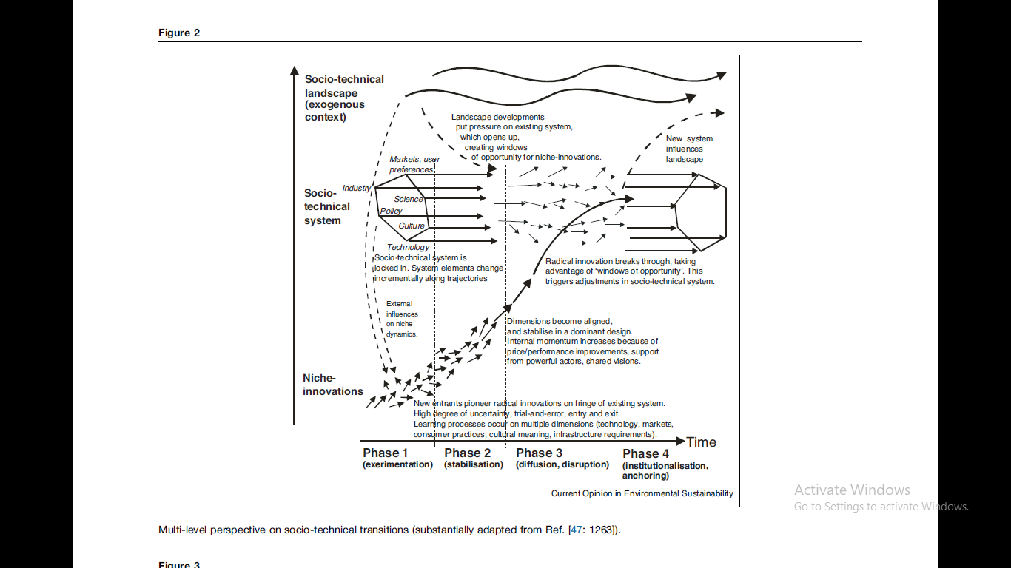
ST – Phases
Sustainability transitions take place in four phases with different core activities in each phase
Phase 1 (Experimentation)
Phase 2 (Stabilisation)
Phase 3 (disruption, disruption)
Phase 4 (institutionalisation, anchoring)
Geels, 2019
Notes:
To study the Sustainable Impact of a company, we followed the Sustainability Impact Assessment structure. This meant evaluating the impact of a business’s performance based upon three pillars of sustainable development:
Environment
Social
Economic

Slide 14
ST – Phases
Sustainability transitions take place in four phases with different core activities in each phase
Phase 1 (Experimentation)
Trial and error learnings, fragmented experiments, prototype development for niche-innovations
Phase 2 (Stabilisation)
Establishment of dominant design, standards and best practices, demonstration projects, collaboration & network formation
Price/performance improvement, process improvement, economies of scale, complementary technology development, regime destabilisation
Phase 3 (disruption, disruption)
Phase 4 (institutionalisation, anchoring)
Change in user habits, policy regulations, and industry standards
Geels, 2019
Notes:
To study the Sustainable Impact of a company, we followed the Sustainability Impact Assessment structure. This meant evaluating the impact of a business’s performance based upon three pillars of sustainable development:
Environment
Social
Economic

Slide 15
Key readings - SI
Azapagic, A., & Perdan, S. (2000). Indicators of sustainable development for industry: a general framework. Process Safety and Environmental Protection, 78(4), 243-261.
Cavanagh, J. A. E., Frame, B., & Lennox, J. (2006). The sustainability assessment model (SAM): measuring sustainable development performance. Australasian Journal of Environmental Management, 13(3), 142-145.
Bae, H., & Smardon, R. S. (2011). Indicators of sustainable business practices. Environmental management in practice, 177.
Pintér, L., Hardi, P., Martinuzzi, A., & Hall, J. (2012). Bellagio STAMP: Principles for sustainability assessment and measurement. Ecological Indicators, 17, 20-28.
Global Reporting Initiative. (2013). G4 sustainability reporting guidelines: Reporting principles and standard disclosures. Amsterdam: Global Reporting Initiative.
Sala, S., Ciuffo, B., & Nijkamp, P. (2015). A systemic framework for sustainability assessment. Ecological Economics, 119, 314-325.
Notes:
To study the Sustainable Impact of a company, we followed the Sustainability Impact Assessment structure. This meant evaluating the impact of a business’s performance based upon three pillars of sustainable development:
Environment
Social
Economic

Slide 16
Key readings - SI
Kemp, R. (1994) ‘Technology and the transition to environmental sustainability’, Futures, 26(10), pp. 1023–1046. doi: 10.1016/0016-3287(94)90071-X.
Geels, F. W. (2002) ‘Technological transitions as evolutionary reconfiguration processes: a multi-level perspective and a case-study’, Research Policy, 31(8), pp. 1257–1274. doi: 10.1016/S0048-7333(02)00062-8.
Geels, F. W., & Schot, J. (2007). Typology of sociotechnical transition pathways. Research policy, 36(3), 399-417.
Geels, F. W. (2011) ‘The multi-level perspective on sustainability transitions: Responses to seven criticisms’, Environmental Innovation and Societal Transitions, 1(1), pp. 24–40. doi: 10.1016/j.eist.2011.02.002
Jacobsson, S. and Bergek, A. (2011) ‘Innovation system analyses and sustainability transitions: Contributions and suggestions for research’, Environmental Innovation and Societal Transitions, 1(1), pp. 41–57. doi: 10.1016/j.eist.2011.04.006.
Farla, J., Markard, J., Raven, R., & Coenen, L. (2012). Sustainability transitions in the making: A closer look at actors, strategies and resources. Technological forecasting and social change, 79(6), 991-998.
Markard, J., Raven, R. and Truffer, B. (2012) ‘Sustainability transitions: An emerging field of research and its prospects’, Research Policy, 41(6), pp. 955–967. doi: 10.1016/j.respol.2012.02.013
Geels, F. W. (2019). Socio-technical transitions to sustainability: a review of criticisms and elaborations of the Multi-Level Perspective. Current opinion in environmental sustainability, 39, 187-201.
Notes:
To study the Sustainable Impact of a company, we followed the Sustainability Impact Assessment structure. This meant evaluating the impact of a business’s performance based upon three pillars of sustainable development:
Environment
Social
Economic

Slide 17
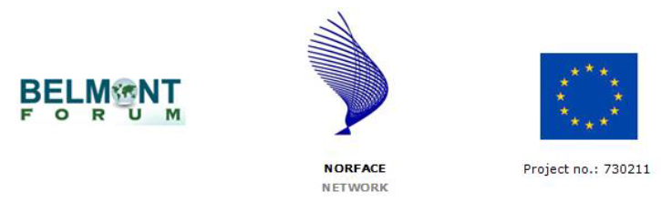
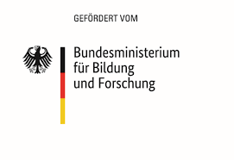
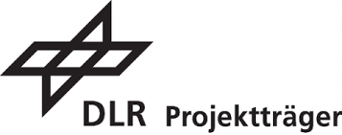
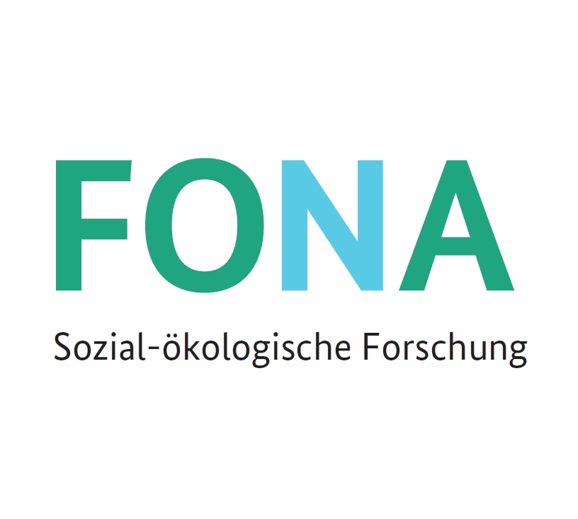


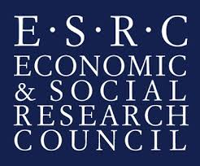
Website: www.ip4sustainability.org
Twitter: @ip4sust
Contact: Elisabeth.Eppinger@HTW-Berlin.de
Funding support: The project IPACST is financially supported by the Belmont Forum and NORFACE Joint Research Programme on Transformations to Sustainability, which is co-funded by DLR/BMBF FONA-SÖF 01UV1812A and 01UV1812B, GCRF, ESRC (ES/S008322/1), VR 2017-06439, and the European Commission through Horizon 2020.

