Slide 1


© Strupeit, 2022
Sustainability and Sustainable Business Models
Lars Strupeit
IIIEE, Lund University, Sweden
Version 2 (31.03.2022)
This is an open access publication distributed under the terms of the Creative Commons Attribution By License, which permits unrestricted use, distribution, and reproduction in any medium, provided the original authors and source are credited.
Citation: Strupeit, L. (2022). Sustainability and Sustainable Business Models. Lund, Sweden.

Slide 2

Sustainability and SBM
Sustainable development: “development that meets the needs of the present without compromising the ability of future generations to meet their own needs.” (WCED, 1987)
Technologies, products, business models and design that contribute to achieving the UN Sustainable Development Goals.
Sustainable Business Model (SBM): one that allows a combination of economic, environmental and social aspects of sustainability to define the organization’s purpose
Aims at reducing negative impacts for the environment and society.
Notes:
First, a good starting point is understanding how IPACST defined sustainability. In the context of the project, "Sustainability" refers to any development that meets the needs of the present without compromising the ability of future generations to meet their own needs. More concretely, this refers to technologies, products, business models and designs that contribute to achieving the UN Sustainable Development Goals.
Each case study was assessed in 3 different ways – based upon its Sustainable Business Model, its Sustainable Impact, and its IP Strategy,
Sustainable Business Model (SBM) refers to a business model that allows a combination of economic, environmental and social aspects of sustainability to define the organization’s purpose. This means that one of the business's primary aim is to reduce negative impacts for the environment and society.
Sustainability Impact ???
IP Strategy means a set of activities and guidance process for decision making regarding exploration, generation/acquisition, protection, exploitation/enforcement and periodic assessment of intellectual property (rights) to maximize value creation and capture from an organization’s inventions like technologies, products, services, literary and artistic works, design, symbols, names and images in support of and thus in alignment with its business objectives.

Slide 3
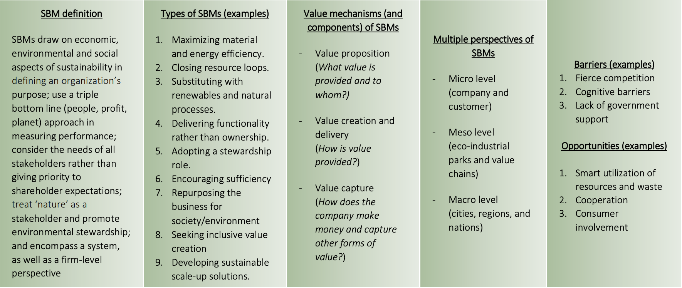
SBM value mechanisms and archetypes
SBMs enable transitions to sustainability by addressing social, environmental and economic concerns, coupled with a strong customer offering.
Notes:
As seen in the table, there are many types of SBMs, but they all enable transitions to sustainability by addressing social, environmental and economic concerns, coupled with a strong customer offering.

Slide 4
Defining characteristics of SBM
A SBM draws on economic, environmental and social aspects of sustainability in defining an organization’s purpose
A SBM Uses a Triple Bottom Line (TBL) approach in measuring performance
A SBM considers the needs of all stakeholders rather than giving priority to shareholders’ expectations
A SBM treats nature as a stakeholder and promotes environmental stewardship
Sustainability leaders, or champions, drive the cultural and structural changes necessary to implement sustainability
An SBM encompasses the systems perspective as well as the firm-level perspective
Source: Stubbs, W., & Cocklin, C. (2008). Conceptualizing a 'sustainability business model'. Organization & Environment, 21(2), 103-127.

Slide 5
Sustainable business model canvas
Value creation
Value proposition
Value delivery
Key activities (processes,
technology development)
Customer relationships
People
Planet
Profit
Key
partners (suppliers)
Customer segments
Key resources
(materials/physical infrastructure, human and financial)
Channels
Cost structure
Revenue streams
Value capture
Adapted from: www.strategyzer.com / Osterwalder (2010)
Notes:
First, a good starting point is understanding how IPACST defined sustainability. In the context of the project, "Sustainability" refers to any development that meets the needs of the present without compromising the ability of future generations to meet their own needs. More concretely, this refers to technologies, products, business models and designs that contribute to achieving the UN Sustainable Development Goals.
Each case study was assessed in 3 different ways – based upon its Sustainable Business Model, its Sustainable Impact, and its IP Strategy,
Sustainable Business Model (SBM) refers to a business model that allows a combination of economic, environmental and social aspects of sustainability to define the organization’s purpose. This means that one of the business's primary aim is to reduce negative impacts for the environment and society.
Sustainability Impact ???
IP Strategy means a set of activities and guidance process for decision making regarding exploration, generation/acquisition, protection, exploitation/enforcement and periodic assessment of intellectual property (rights) to maximize value creation and capture from an organization’s inventions like technologies, products, services, literary and artistic works, design, symbols, names and images in support of and thus in alignment with its business objectives.

Slide 6
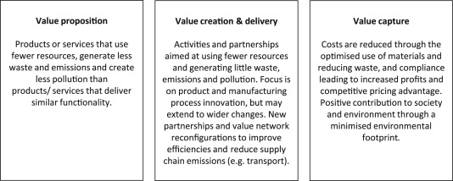
SBM types (I): Maximizing material and energy efficiency
Do more with less resources, generate less waste, emissions, pollution
Examples
De-materialization
Low-carbon solutions
Low carbon manufacturing
Increased functionality
Lean manufacturing
Value mechanisms
Suggested readings
Weizsäcker, E., von Lovins, A., Lovins, L., 1997. Factor Four: Doubling Wealth - Halving Resource Use: The New Report to the Club of Rome. Earthscan Publications Ltd, London.
Diaz Lopez, F. J., Bastein, T., & Tukker, A. (2019). Business model innovation for resource-efficiency, circularity and cleaner production: What 143 cases tell us. Ecological Economics, 155, 20-35.
Bocken, Short, Evans (2014)
Notes:
As seen in the table, there are many types of SBMs, but they all enable transitions to sustainability by addressing social, environmental and economic concerns, coupled with a strong customer offering.

Slide 7
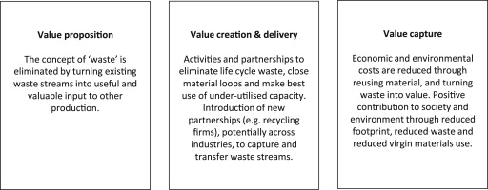
SBM types (II): Closing resource loops
Turn waste streams into resources for other products and processes
Examples
Circular economy, closed loop
Industrial symbiosis
Cradle-2-cradle
Reuse, recycle, remanufacture
Take-back management
Value mechanisms
Suggested readings
Geissdoerfer, M., Savaget, P., Bocken, N. M., & Hultink, E. J. (2017). The Circular Economy–A new sustainability paradigm?. Journal of cleaner production, 143, 757-768.
Ellen MacArthur Foundation: www.ellenmacarthurfoundation.org/
Bocken, Short, Evans (2014)
Notes:
As seen in the table, there are many types of SBMs, but they all enable transitions to sustainability by addressing social, environmental and economic concerns, coupled with a strong customer offering.

Slide 8
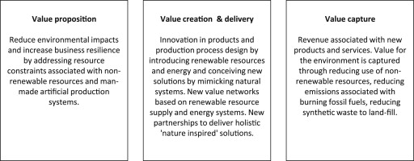
SBM types (III): Substituting with natural and renewable
processes
Substitute with ‘green’ energy and use processes with reduced emissions
Examples
Move from non-renewable to renewable energy sources
Bioeconomy
Zero emissions initiative
Value mechanisms
Suggested readings
Burger, S. P., & Luke, M. (2017). Business models for distributed energy resources: A review and empirical analysis. Energy Policy, 109, 230-248
Salvador, R., Puglieri, F. N., Halog, A., Andrade, F. G. D., Piekarski, C. M., & De Francisco, A. C. (2021). Key aspects for designing business models for a circular bioeconomy. Journal of Cleaner Production, 278
Bocken, Short, Evans (2014)
Notes:
As seen in the table, there are many types of SBMs, but they all enable transitions to sustainability by addressing social, environmental and economic concerns, coupled with a strong customer offering.

Slide 9
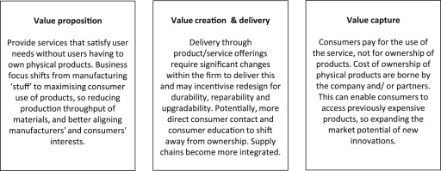
SBM types (IV): Delivering functionality rather than
ownership
Provide services that satisfy user needs without having to own physical products
Examples
Product-oriented product-service system: maintenance, extended warrantee
Use-oriented product-service system: rental, lease, shared
Result-oriented product-service system: pay-per-use
Value mechanisms
Suggested readings
Tukker, A. (2004). Eight types of product–service system: eight ways to sustainability? Experiences from SusProNet. Business strategy and the environment, 13(4), 246-260.
Reim, W., Parida, V., & Örtqvist, D. (2015). Product-service systems (PSS) business models and tactics - A systematic literature review. Journal of Cleaner Production, 97, 61-75.
Bocken, Short, Evans (2014)
Notes:
As seen in the table, there are many types of SBMs, but they all enable transitions to sustainability by addressing social, environmental and economic concerns, coupled with a strong customer offering.

Slide 10
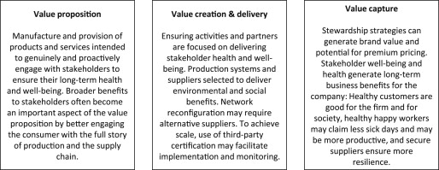
SBM types (V): Adopting a stewardship role
Deliver social and environmental benefits, rather than economic profit maximisation
Examples
Biodiversity protection
Ethical trade (fair trade)
Consumer care – promote consumer health and well-being
Radical transparency about environmental / societal impacts
Choice editing by retailers
Value mechanisms
Suggested readings
Bocken, N., Short, S., Rana, P., Evans, S. 2014. A literature and practice review to develop Sustainable Business Model Archetypes. Journal of Cleaner Production, 65, 42–56
Hickle, G. (2007). Promoting product stewardship with eco-labels, certification programs, and product standards. Environmental Quality Management, 16(3), 1-9.
Bocken, Short, Evans (2014)
Notes:
As seen in the table, there are many types of SBMs, but they all enable transitions to sustainability by addressing social, environmental and economic concerns, coupled with a strong customer offering.

Slide 11
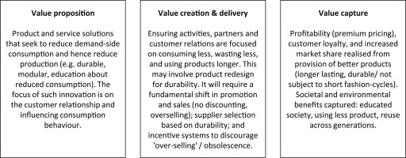
SBM types (VI): Encouraging sufficiency
Seek to reduce consumption and production
Examples
Consumer education / communication
Product longevity
Slow fashion
Premium branding / limited availability
Demand management
Frugal business
Value mechanisms
Suggested readings
Bocken, N. M., & Short, S. W. (2016). Towards a sufficiency-driven business model: Experiences and opportunities. Environmental Innovation and Societal Transitions, 18, 41-61
Niessen, L., & Bocken, N. M. P. (2021). How can businesses drive sufficiency? the business for sufficiency framework. Sustainable Production and Consumption, 28, 1090-1103
Bocken, Short, Evans (2014)
Notes:
As seen in the table, there are many types of SBMs, but they all enable transitions to sustainability by addressing social, environmental and economic concerns, coupled with a strong customer offering.

Slide 12
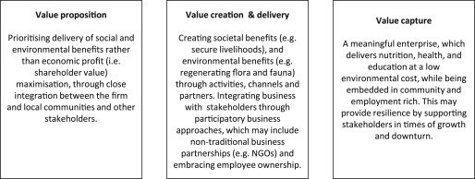
SBM types (VII): Repurposing the company for society
and environment
Integrate business in local communities through employee
ownership and collaborative approaches
Examples
Not for profit
Hybrid businesses, social enterprise (for profit)
Social and biodiversity regeneration initiatives
Alternative ownership: cooperative, mutual, collectives
Value mechanisms
Suggested readings
Santos, F., Pache, A. -., & Birkholz, C. (2015). Making hybrids work: Aligning business models and organizational design for social enterprises. California Management Review, 57(3), 36-58.
Doherty, B., Haugh, H., & Lyon, F. (2014). Social enterprises as hybrid organizations: A review and research agenda. International Journal of Management Reviews, 16(4), 417-436.
Bocken, Short, Evans (2014)
Notes:
As seen in the table, there are many types of SBMs, but they all enable transitions to sustainability by addressing social, environmental and economic concerns, coupled with a strong customer offering.

Slide 13
SBM types (VIII): Inclusive value creation
Sharing resources, knowledge, ownership, and wealth creation
Examples
Collaborative approaches
(sourcing, production, lobbying)
Peer-to-peer sharing
Inclusive innovation
Base of pyramid solutions
Suggested readings
Prahalad, C. K. (2012). Bottom of the Pyramid as a Source of Breakthrough Innovations. Journal of Product Innovation Management, 29(1), 6–12.
Novikov, O. (2022). Peer-to-Peer Business Model: Navigating between Social and Economic Pressures. International Journal of Trade, Economics and Finance 13(2), 4
Notes:
As seen in the table, there are many types of SBMs, but they all enable transitions to sustainability by addressing social, environmental and economic concerns, coupled with a strong customer offering.

Slide 14
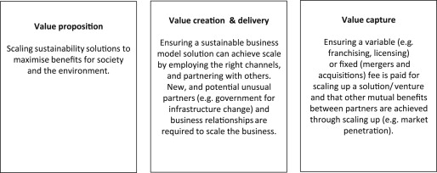
SBM types (IX): Deliver sustainable scale-up solutions
Deliver sustainable solutions at a large scale to maximise benefits for society
and the environment
Examples
Impact investing
Patient / slow capital
Peer-to-peer lending
Crowdsourcing funding
Open innovation (platforms)
Incubator and entrepreneur support models
Value mechanisms
Suggested readings
Messeni Petruzzelli, A., Natalicchio, A., Panniello, U., & Roma, P. (2019). Understanding the crowdfunding phenomenon and its implications for sustainability. Technological Forecasting and Social Change, 141, 138-148.
Bocken, Short, Evans (2014)
Notes:
As seen in the table, there are many types of SBMs, but they all enable transitions to sustainability by addressing social, environmental and economic concerns, coupled with a strong customer offering.

Slide 15
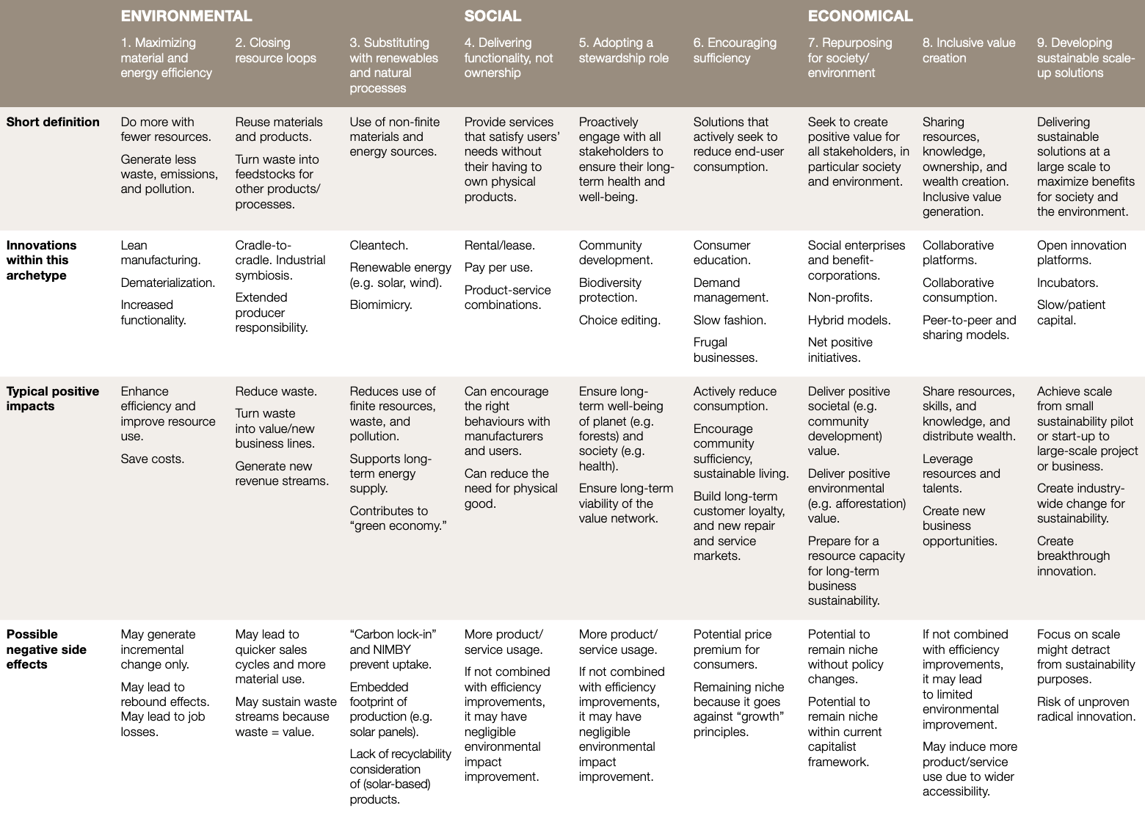
SBM types: Summary
Lüdeke-Freund, F., Massa, L., Bocken, N., Brent, A., & Musango, J. (2016)
Notes:
As seen in the table, there are many types of SBMs, but they all enable transitions to sustainability by addressing social, environmental and economic concerns, coupled with a strong customer offering.

Slide 16
The role of IP in the SBM
Value creation
IP-model
Value proposition
Value delivery
Key activities (processes,
technology development)
Customer relationships
People
Planet
Profit
Key
partners (suppliers)
Customer segments
IP-model
IP-model
Key resources
(materials/physical infrastructure, human and financial)
Channels
Cost structure
Revenue streams
Value capture
IP-model
IP-model
IP-model
IP-model
Adapted from: www.strategyzer.com / Osterwalder (2010)
Notes:
First, a good starting point is understanding how IPACST defined sustainability. In the context of the project, "Sustainability" refers to any development that meets the needs of the present without compromising the ability of future generations to meet their own needs. More concretely, this refers to technologies, products, business models and designs that contribute to achieving the UN Sustainable Development Goals.
Each case study was assessed in 3 different ways – based upon its Sustainable Business Model, its Sustainable Impact, and its IP Strategy,
Sustainable Business Model (SBM) refers to a business model that allows a combination of economic, environmental and social aspects of sustainability to define the organization’s purpose. This means that one of the business's primary aim is to reduce negative impacts for the environment and society.
Sustainability Impact ???
IP Strategy means a set of activities and guidance process for decision making regarding exploration, generation/acquisition, protection, exploitation/enforcement and periodic assessment of intellectual property (rights) to maximize value creation and capture from an organization’s inventions like technologies, products, services, literary and artistic works, design, symbols, names and images in support of and thus in alignment with its business objectives.

Slide 17
The role of IP in the SBM
A firm’s IP model (or IP portfolio) affects the various building blocks of a (sustainable) business model in various ways
Key partners
  Example
  Example
Key activities
  Example
  Example
Key resources
  Example
  Example
Cost structure
  Expenditure for patents
  Expenditure for in-licensing
Revenue streams
  Expenditure for out-licensing
  Example
Channels
  Example
  Example
Customer segments
  Example
  Example
Notes:
First, a good starting point is understanding how IPACST defined sustainability. In the context of the project, "Sustainability" refers to any development that meets the needs of the present without compromising the ability of future generations to meet their own needs. More concretely, this refers to technologies, products, business models and designs that contribute to achieving the UN Sustainable Development Goals.
Each case study was assessed in 3 different ways – based upon its Sustainable Business Model, its Sustainable Impact, and its IP Strategy,
Sustainable Business Model (SBM) refers to a business model that allows a combination of economic, environmental and social aspects of sustainability to define the organization’s purpose. This means that one of the business's primary aim is to reduce negative impacts for the environment and society.
Sustainability Impact ???
IP Strategy means a set of activities and guidance process for decision making regarding exploration, generation/acquisition, protection, exploitation/enforcement and periodic assessment of intellectual property (rights) to maximize value creation and capture from an organization’s inventions like technologies, products, services, literary and artistic works, design, symbols, names and images in support of and thus in alignment with its business objectives.

Slide 18
Literature for further reading
Adams, R., Jeanrenaud, S., Bessant, J., Denyer, D., & Overy, P. (2016). Sustainability-oriented innovation: a systematic review. International Journal of Management Reviews, 18(2), 180 205.
Bakker, C., Wang, F., Huisman, J., & den Hollander, M. (2014). Products that go round: exploring product life extension through design. Journal of Cleaner Production, 69, 10-16.
Blomsma, F., Brennan, G. 2017. The Emergence of Circular Economy J. Industrial Ecology , 21 (3).
Bocken, N., Boons, F., & Baldassarre, B. (2019). Sustainable business model experimentation by understanding ecologies of business models. Journal of Cleaner Production, 208, 1498-1512.
Bocken, N.M.P., Ritala, P. Huotari, P. 2017. The circular economy: Exploring the introduction of the concept among S&P 500 firms. Journal of Industrial Ecology. 21 (3), 487–490.
Bocken, N. M., Schuit, C. S., & Kraaijenhagen, C. 2018. Experimenting with a circular business model: Lessons from eight cases. Environmental innovation and societal transitions, 28, 79-95
Bocken, N. M., & Short, S. W. (2016). Towards a sufficiency-driven business model: Experiences and opportunities. Environmental Innovation and Societal Transitions, 18, 41-61.
Bocken, N., Short, S., Rana, P., Evans, S. 2013. A value mapping tool for sustainable business modelling. Corporate Governance, 13 (5), 482 – 497
Bocken, N., Short, S., Rana, P., Evans, S. 2014. A literature and practice review to develop Sustainable Business Model Archetypes. Journal of Cleaner Production, 65, 42–56
Bocken, N.M.P., de Pauw, I., van der Grinten, B., Bakker, C. 2016. Product design and business model strategies for a circular economy. Journal of Industrial and Production Engineering, 32 (1), 81
Geissdoerfer, M., Savaget, P., Bocken, N. M., & Hultink, E. J. (2017). The Circular Economy–A new sustainability paradigm? Journal of Cleaner production, 143, 757-768.
Hart, S. L., & Milstein, M. B. (2003). Creating sustainable value. Academy of Management Perspectives, 17(2), 56-67.
Kraaijenhagen, C., Van Oppen, C., Bocken. N. (2016), Circular business. Collaborate & Circulate. Circular Collaboration, Amersfoort, The Netherlands. Available at circularcollaboration.com
Lüdeke-Freund, F., Massa, L., Bocken, N., Brent, A., & Musango, J. (2016). Business models for shared value. Network for Business Sustainability: South Africa.
Osterwalder, A., & Pigneur, Y. (2010). Business model generation: a handbook for visionaries, game changers, and challengers. John Wiley & Sons.
Stubbs, W., & Cocklin, C. (2008). Conceptualizing a 'sustainability business model'. Organization & Environment, 21(2), 103-127.
Tukker, A. (2004). Eight types of product–service system: eight ways to sustainability? Experiences from SusProNet. Business strategy and the environment, 13(4), 246-260.
Tukker, A., Bulavskaya, T., Giljum, S., de Koning, A., Lutter, S., Simas, M., ... & Wood, R. 2016. Environmental and resource footprints in a global context: Europe’s structural deficit in resource endowments. Global Environmental Change, 40, 171-181.
Notes:
As seen in the table, there are many types of SBMs, but they all enable transitions to sustainability by addressing social, environmental and economic concerns, coupled with a strong customer offering.

Slide 19

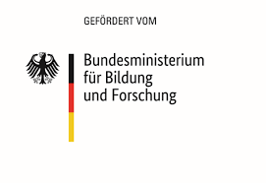

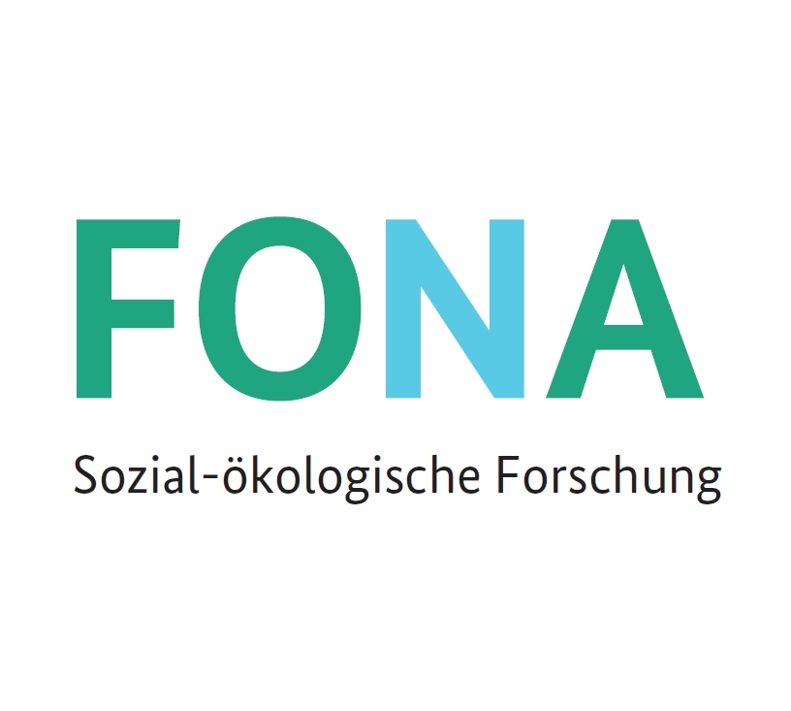



Website: www.ip4sustainability.org
Twitter: @ip4sust
Contact: lars.strupeit@iiiee.lu.se
Funding support: The project IPACST is financially supported by the Belmont Forum and NORFACE Joint Research Programme on Transformations to Sustainability, which is co-funded by DLR/BMBF FONA-SÖF 01UV1812A and 01UV1812B, GCRF, ESRC (ES/S008322/1), VR 2017-06439, and the European Commission through Horizon 2020.

