Slide 1


© Jain, Gurtoo, 2022
Intellectual Property Strategy Transforming Mobility Towards Sustainability:
An Environment Impact Case Study of Ather Energy
Akriti Jain, Anjula Gurtoo
Centre for Society and Policy (CSP)
Indian Institute of Science - Bangalore, India
Version 3 (05.01.2022)
This is an open access publication distributed under the terms of the Creative Commons Attribution By License, which permits unrestricted use, distribution, and reproduction in any medium, provided the original authors and source are credited.
Citation: Jain, A., & Gurtoo, A. (2021). Intellectual Property Strategy transforming Mobility towards Sustainability: An Environment Impact Case Study of Ather Energy. Indian Institute of Science – Bangalore , India.

Slide 2

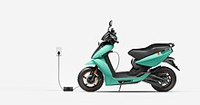

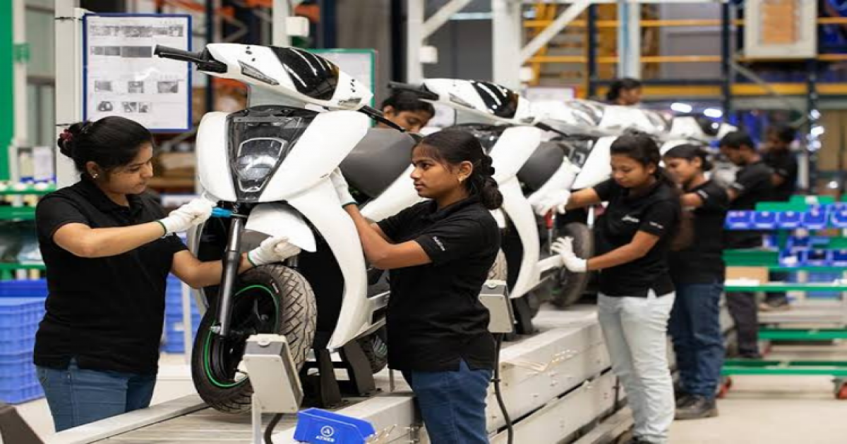
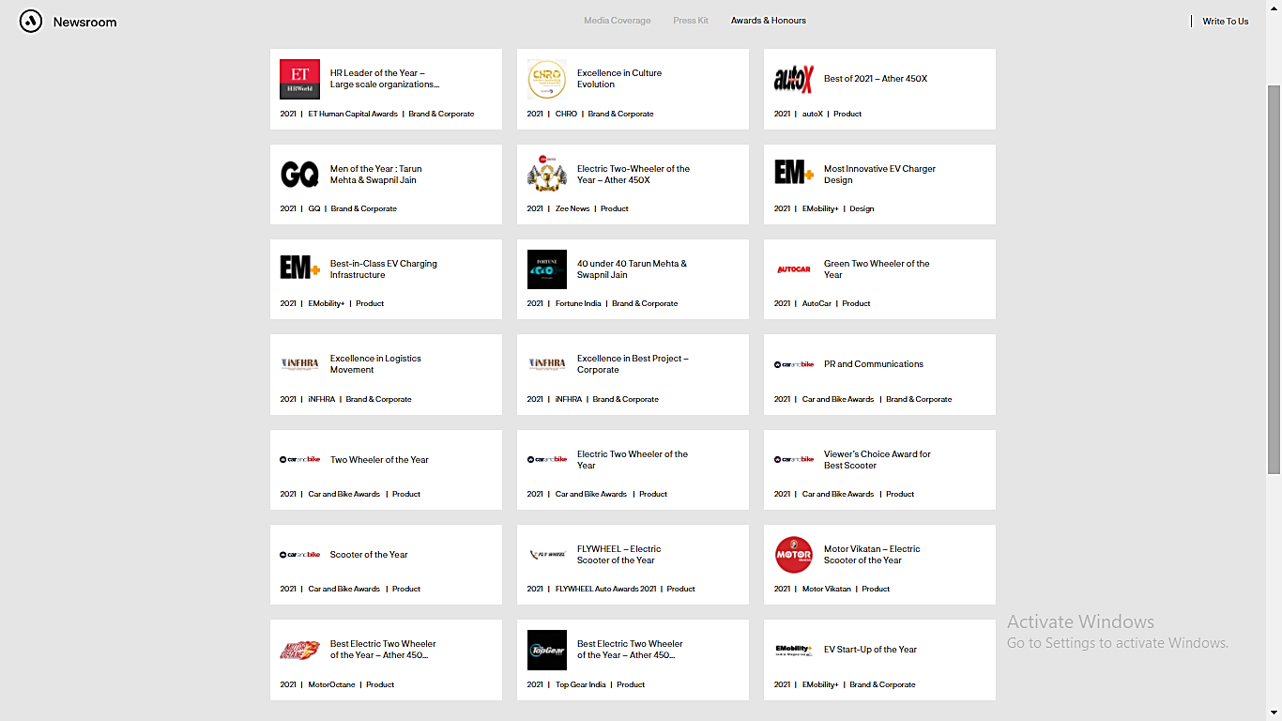
About Ather Energy
Business Profile - Ather Energy manufactures innovative Internet of Things (IoT) based intelligent two-wheeler electric scooters and builds a supportive e-mobility ecosystem in India.
https://en.wikipedia.org/wiki/File:AtherLogo.jpg
An institute spin-off turned India' leading Electric Vehicle (EV) manufacturer, Ather Energy, was founded in 2013 by two engineering graduates to transform India‘s automobile sector towards environmental sustainability. The company built its prototype of EV two-wheeler in 2016 at the Indian Institute of Technology - Madras Incubation Cell and has evolved to building its most extensive e-mobility infrastructure and ecosystem around charging, supply-chain, customer service across the country. Building on its intellectual capital (60+ patent applications, 110+ trademarks and 130+ design rights), human capital (800+ employees with 14% female employees), financial capital (90+ million USD raised), and operational efficiency, the company has created an environmental impact by saving 7.5 metric tons of CO2 emissions.
Source: https://en.wikipedia.org/wiki/File:Ather_450X_.jpg
Source: https://assets.atherenergy.com/Ather_Energy's_Impact_Report_2020.pdf
Sustainable Business Model (SBM) - Ather Energy's fundamental value proposition lies in reduced upfront cost and seamless experience of riding a sustainable energy-based, efficient, and IoT based e-vehicle and building an e-mobility ecosystem. It adopts a combination of (a) maximizing efficiency (SBM-1) and (b) deliver functionality rather than ownership (SBM-4) business models. Value creation of energy-efficient, long-lasting lithium-ion battery packs comes through vertical integration and partnerships. The company delivers and captures value through leasing and subscription schemes, ensuring affordability, reduced upfront cost, regular maintenance, and increased customer relations with the user, thus increasing the adoption of e-vehicle in the Indian population. The company has recently adopted the closing resource loop (SBM-2) business model. It offers replacement or buyback of the battery after three years or once it reaches 70% of its capacity. It ensures safe disposal, end-of-life recycling, and reusing the vehicle's lithium-ion batteries for secondary applications.
https://brifly-media.s3.ap-south-1.amazonaws.com/s3fs-public/styles/fb_1200x630/public/article/2021-11/Ather%27s%20New%20Plant.png?itok=BKEKsfD0
Awards and Honours - The company is awarded for its breakthrough design, innovation, and best-in-class IP and HR practices. In 2020, Niti Ayog, Government of India, awarded Ather Energy with the IPR leadership award for excellent contribution in the field of patents. In 2021, UK-Based Clarivate recognized Ather Energy as one of the top investors in south and southeast Asia. EMobility+ awarded the company for the most innovative EV charger design and best-in-class EV charging infrastructure awards in the same year. During 2016-2020, the company was awarded several times for its best HR practices, design and innovation, and for promoting sustainability and development in the company and socially.
Source: https://www.pinterest.co.uk/pin/206250857907956833/
Source: https://press.atherenergy.com/awards-honours/

Slide 3
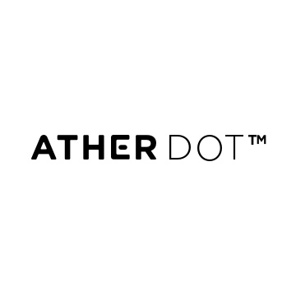


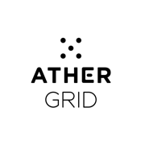
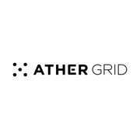





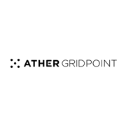

Ather Energy’s IP asset portfolio
Patents, design rights and trademark filings
Important IP assets | Internally generated and fully owned IP
2010-2013 | 2014 | 2015 | 2016 | 2017 | 2018
Trade-secrets
Algorithms, software and firmware
01 design right application
56 design rights applications
52 design rights applications
9 design rights applications
3
7
11
15
19
23
24
25
29
30
31
32
1
2
4
8
12
16
20
26
27
28
5
9
13
17
21
33
34
35
36
Data
Machine and vehicle data generated by the embedded software
6
10
14
18
1
Patent applications
Trademark portfolio
Logo
Wordmark
Ather
Ather Energy
Ather 450
Ather450
Ather Grid
TrueRange
Source: https://blog.atherenergy.com/soft-things-about-hard-things-e849aa2b62e6
https://www.quickcompany.in/design?utf8=%E2%9C%93&q=ather+energy
https://ipindiaservices.gov.in/PublicSearch/PublicationSearch/Search
https://www.atherenergy.com/trademarks

Slide 4
Ather Energy’s IP strategy and SBM evolution
2013 | 2014 | 2015 | 2016 | 2017 | 2018 | 2019-2022
Sustainability Transition
Company – Company (C-C) transition
Learning strategy maturing to re-visioning, Re-purposing, & Re-branding ; Eco-efficiency; broadened value proposition
Company-sector (C-S) transition
Facilitating the entry of new entrants & catalysing e-mobility infrastructure & ecosystem
No market for battery packs + No player in electric 2-wheeler space
FAME India I (Faster Adoption & Manufacturing of (Hybrid) & EV Scheme (April)
Incumbent funding (October)
FAME India II Scheme
Environment
Strategic direction from executive from incumbent
Touchscreen dashboard
OTA Software update
Launch of IoT based e-scooter
+
Fast public charging stations for EV
Lithium-ion battery packs &
2-wheeler platform
Institute endowment funding
Prototype demonstration of IoT based two wheeler EV
Profile
Angel investor & VC funding
On-board diagnostic
GPS
Appointment of new director –joined from MNC OEM
SBM 1 - Maximizing efficiency
Value creation & delivery
Internal R&D with institute endowment, angel investors’ and venture capital funds, critical human resource (top management, Industrial design team, Data intelligent team etc.) Manufacturing plant, Charging stations, experience centers
Value capture
Break-even at 50,000 units’ sales mark
Leasing, rental & subscription scheme
SBM 4 - Deliver functionality rather than ownership
SBM
SBM 2 - Closing Resource Loop
Buyback program
Club (semi-open Type 1) IP model
Know-how out-sharing with other battery manufacturing start-ups
“In the absence of a standard connector for light electric vehicles, Ather has developed one and also released the intellectual property (IP) on the connector, making it accessible to anyone looking to design and build EVs to further the mission of a sustainable energy ecosystem.. Tearing down the IP walls here and helping with engineering at an early stage will help drive a common standard” CEO
Private (closed) IP model
no sharing of IP for value capture, acknowledgement to engineers, freedom to operate, to avoid litigation
Fully-open IP model
Releasing IP on rapid charging technology to standardise two-wheeler charging adapter/connector for all EVs
IP Strategy
Common (semi-open Type 2) IP model
Defensive publication + open-source software with some restriction on commercial use
Transitions
Company – Company transitions
Learning strategy maturing to re-visioning, Re-purposing, & Re-branding ; Eco-efficiency; broadened value proposition
Company – Sector transitions
Inter-firm collaboration in the same industry; Advocacy, coalitions, lobbying leading strategy' inspiring others for sustainability
Sources: https://automotivedesignplanet.com/ather-energy-releasing-patents/
https://www.firstpost.com/tech/auto-tech/why-ather-energy-thinks-sharing-its-fast-charging-tech-will-boost-electric-two-wheeler-sales-in-india-9877051.html
https://assets.atherenergy.com/Ather_Energy's_Impact_Report_2020.pdf

Slide 5



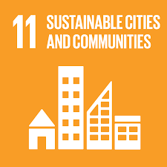

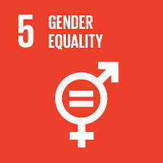

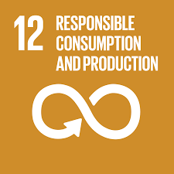

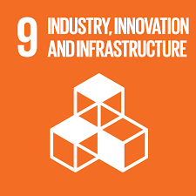
Ather Energy’s sustainability impact
Environmental Impact
Global Impact – GHG emission reduction: Saved 7.5 metric tons of CO2 emission through the vehicle, no usage of plastic bottles across organization saved 17.5 MT of CO2 emissions
Local Impact – waste management & 3R: Recycling of e-waste through registered recyclers & using the used batteries for secondary purpose, in-house sewage plant reduces water wastage
Environment improvement beyond compliance: supporting government in formulating
policies and standard for EV and implementing best-practices for waste management
Labour practices- equity: Employed more than 800 employees with 14% female employees. Of all female employees, 30% are employed in manufacturing facility and 27% are line supervisors
    Labour practices - Human rights: Organise community building calendars with events or activities around
topics like gender, LGBTQIA, multi-regional dialogues, age etc.
    Training & development: Employees receive 20 hours of training per year and provide 3000 hours of training to graduates trainees and 1117 hours of training to factory associate on EV technology
        Community development: Formula Bharat program to train students on EV design, software and IoT technology
Social
Impact
Economic
Impact
Profit & sales contribution of sustainable technologies: Ather Energy has sold more than 6000 vehicles, and expanded across 10 cities with 125 charging stations, as on Feb 2021.
Capital investment in sustainable technologies: Building a network of charging grids and charging stations
within 4 kilometres radius in every city of launch
Increased R&D investment for battery efficiency, reliability and safety
Sources: https://assets.atherenergy.com/Ather_Energy's_Impact_Report_2020.pdf

Slide 6
Key learnings: IP strategies for sustainability
Registration and ownership of formal and informal IP assets are essential for an SDG oriented technology start-up firm in the prototyping, technology development and demonstration stage for the following principal reasons:
  To acknowledge the R&D efforts of engineers and inventors and obtain returns on Investment (ROI). IP protection and ownership, in turn, ensure the economic sustainability of the start-up firm.
  To obtain freedom to operate and avoid potential litigation from other significant competitors in the conventional non-green technology field.
  To facilitate the sectoral transition towards sustainability. In the early technology development stage, published patent applications by technology start-ups are a signalling tool to attract strategic investment and partnerships from large MNCs with limited green-technology capacity. Through such investments, large MNCs can transition towards sustainability by first facilitating the marketing and diffusion of green technologies and then entering into new green technology development.
  An SDG oriented, sustainable-technology start-up can experiment with one or multiple combinations of relatively open IP models, i.e. club-IP model, common-IP model, and fully-open IP model in the application and diffusion phase of sustainable-technology field once the company has built a reputation in this technology. By adopting relatively open IP models, the firm can encourage the entry of new firms and build ecosystem and infrastructure around the green technology field, thus accelerating the company to the sector, i.e. C-S transition towards sustainability.

Slide 7
Key learnings: IP strategies for sustainability
  Adopting club (semi-open-1) IP model, i.e. out-sharing of know-how of the sustainable technology's core component with other small and new start-up firms can help the company develop a future supplier base in the emerging green technology industry sustainability. This, in turn, creates a positive environmental impact and enable the sectoral transition towards sustainability.
  A common (semi-open 2) IP model, e.g. defensive publication and open source software with some restrictions on its' commercial use, can help the company to put in the public domain the newly redesigned and improved version of the previously proprietary technology for new applications and wider diffusion of sustainable technology. It creates a positive environmental impact (through environment improvement beyond compliance), social impact (through encouraging new start-ups and employment generation), and economic impact (through new industry development and encouraging green investment by others).
  Adopting a fully-open IP model (i.e. releasing the formal IP like patents in the public domain) for complex green technology helps accelerate the development of new sustainable-technology standards. This effect is enhanced if the company also shares the complementary informal IP (i.e. industrial and technology know-how) with new players or potential technology users.

Slide 8







Website: www.ip4sustainability.org
Twitter: @ip4sust
Contact: pv302@cam.ac.uk | ft263@cam.ac.uk | mhce2@cam.ac.uk
Funding support: The project IPACST is financially supported by the Belmont Forum and NORFACE Joint Research Programme on Transformations to Sustainability, which is co-funded by DLR/BMBF FONA-SÖF 01UV1812A and 01UV1812B, GCRF, ESRC (ES/S008322/1), VR 2017-06439, and the European Commission through Horizon 2020.

